Slide 1
Ethernet-based interconnect, the critical crossroads for HPC & AI networking at scale
(exforum112s1)
Eric Eppe
Corporate VP – Portfolio & Strategy HPC/AI/Quantum

Slide 2
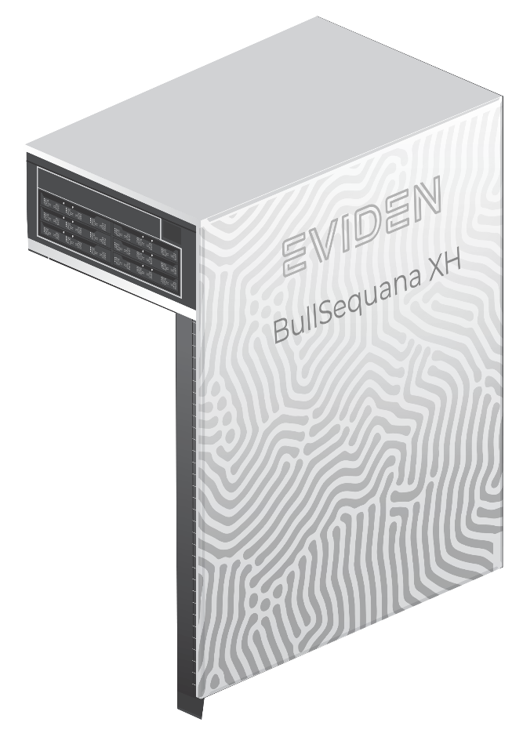
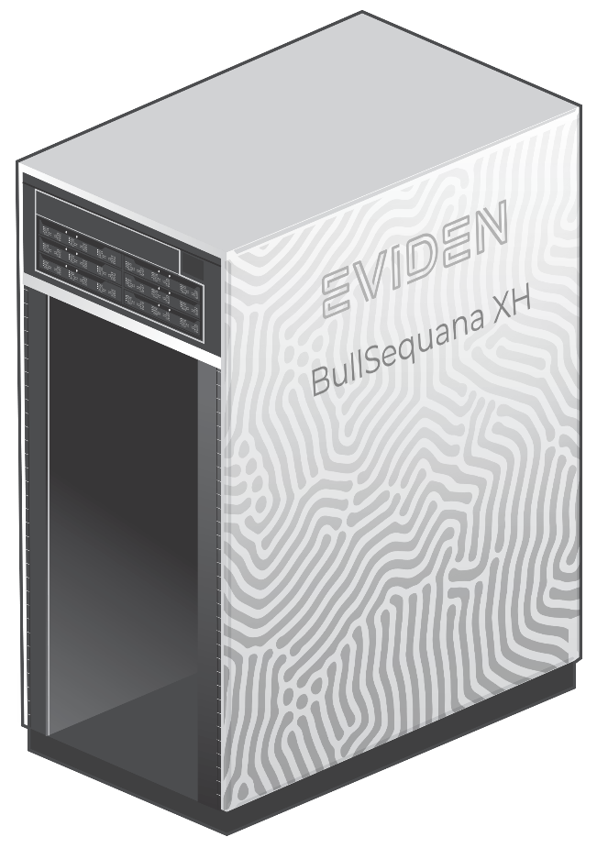
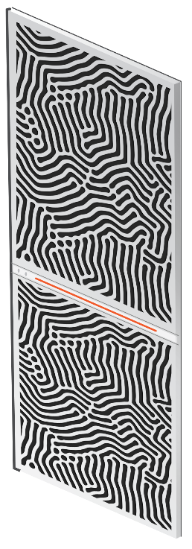
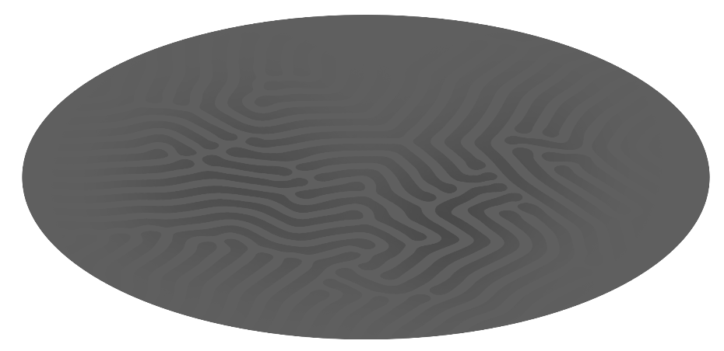
2023 Best kept secret
HPC & AI/ML have converged characteristics
An Exascale Capable
SuperComputer
An LLM Capable
SuperComputer

Slide 3
2023 Best kept secret
HPC & AI/ML have converged characteristics
An Exascale Capable
SuperComputer
A GPT4 LLM Capable
SuperComputer

Slide 4
2023 Best kept secret
HPC & AI/ML have converged characteristics
An Exascale Capable
SuperComputer
A GPT4 LLM Capable
SuperComputer
1 Quintillion Flops
1 Trillion Parameters
100+ racks
/ 300+ racks*
25.000
HS Network Endpoints
25.000 GPUS
* Mostly less dense Air Cooled systems

Slide 5
High Speed Networking for large scale HPC & AI/ML
What are the key criterias to monitor?
HPC
AI/ML
15/20% of total HW costs in highly dense infrastructure
Higher BW will double costs
Costs
>30% of total HW costs in AirCooled infrastructure
Higher BW will double costs
RDMA
MPI
OFI
ccNUMA
SW APIs
RDMA
NCCL/CUDA/CuDNN
RCCL/ROCm/OneAPI
100-400Gb/s (2023)
Sub 300ns P2P latency
Sub 0.9us OSU latency
Bandwidth & Latency
Higher BW the better
Latency not an issue now (but may be in the future)
QoS
Lossless
Congestion control
Scalability & topology
Lossless/Lossy
Congestion control

Slide 6
High Speed Networking for large scale HPC & AI/ML
What are the key criterias to monitor?
Eviden BXI
Infiniband
(Low Latency Protocols)
HPC
RoCE
Infiniband
AI/ML
Costs
SW APIs
Bandwidth & Latency
Scalability & topology

Slide 7
Ethernet Based Interconnect
Promises and challenges
Ethernet has a vast Ecosystem of components, makers, thus a large volume to decrease costs while increasing speeds
Cost is also a matter of topology & density, higher density = less cabling costs (and vice versa)
RoCE has limitations and large scale RDMA in ScaleUP/ScaleOUT environnement needs an evolution
HPC and AI types of semantics are quite similar (collective operations) and can be implemented on top of existing APIs
COSTS
Software
Ethernet is not designed for large scale (10s of thousands) coordinated bursty traffic
Very efficient Congestion management is required, hence Lossles and QoS (traffic classes)
Ethernet requires changes to reach low latencies
HPC & AI have different traffic patterns but are using equivalent packet sizes (large)
Low latency is a must for HPC, will be for AI when BW will have reached a limit
BW & Latency
SCALE

Slide 8









UEC & BXI
Ultra Ethernet Consortium
  EVIDEN is a founding and board member of the UEC
  The only European company in the consortium

Slide 9
Thanks
Eric Eppe
eric.eppe@eviden.com

