Slide 1
Overcoming the Cost of Data Movement in AI Inference
Arun Iyengar, CEO
SC23

Slide 2





About Untether AI
Founded in 2018
Location in Toronto and Silicon Valley
Close ties to AI academia
~170 employees
$170M raised
We help companies executing AI workloads to run neural networks faster, cooler, and cost effectively by using
At-Memory Computation
Notes:
Hello, I’m Arun Iyengar, CEO of Untether AI. I’d like to tell you a little about Untether AI before we get started. We are a hardware company headquartered in Toronto, with a presence here in Silicon Valley as well, focused on high performant, cost effective, energy efficient AI inference based THE at-memory architecture. More on at-memory later in the discussion. We were founded 5 years ago and our base in Toronto gives us close ties to lead local institutions such as the University of Toronto and the University of Waterloo. We are a hybrid company with 170 employees with an office in downtown Toronto and the remaining employees remote. We’ve raised $170M from Tracker Capital, Intel Capital, CPP, Radical and GM. We are shipping our first generation product today which has been primarily focused on convolutional neural networks…
wite
Key Takeaways:
We make hardware and software for AI inference
Well-funded and well-staffed
High quality investors: Intel for silicon, Tracker for government guidance, Radical for AI software, CPP being one of the largest in Canada

Slide 3
Generative AI is the latest AI use case accelerant
Source: McKinsey
Notes:
We’re now seeing the rise of Generative AI. Despite the hype around chatbots and philosophical discussions around a potential future existential crisis, hyperbole aside, analyst firms have been digging to understand the potential sustained economic impact of Generative AI. A recent study from one of those firms, McKinsey shows that Generative AI is truly an AI usage accelerant. What you can see from this chart is that the global economic impact of just new Generative AI use cases will result in a 15 to 40 percent positive economic impact with another 35 to 70 percent positive economic impact coming from worker productivity beyond that. The overall Generative AI impact is expected to grow the overall AI based economy from 11 to 17.7 trillion dollars to a whopping 17.1 to 25.6 trillion dollars. We may debate the numbers and the timeframe which is arguably a decade or so out in time but there’s overwhelming consensus on economic impact…
https://www.mckinsey.com/capabilities/mckinsey-digital/our-insights/the-economic-potential-of-generative-ai-the-next-productivity-frontier#business-value

Slide 4
Generative AI Market Will Be Underpinned by Inference
Revenue ($M) | 2022 | 2027E | 2032E | 2022-2032 CAGR
Inference HW - Devices Total | $4,128 | $82,965 | $168,233 | 45%
Inference HW – Computer Vision | $1,032 | $22,124 | $60,564 | 50%
Inference HW – Conversational AI | $3,096 | $60,841 | $107,669 | 43%
Overall market “growth could expand at a CAGR of 42%, driven by training infrastructure in the near-term and gradually shifting to inference devices for large language models (LLMs)..”
Source: Bloomberg
Notes:
And that impact based on increased Generative AI usage equates to the rise of AI inference. In this study by Bloomberg which breaks down the impact of Generative AI on hardware and software, I’m going to focus on the impact on AI Inference hardware. The overall market for AI Inference Hardware is expected to grow by 45% annually over the next 10ish years. Although conversational use cases are prevalent, computer vision use cases will remain a substantial percentage of the business. When looking at the overall market which is expected to reach $1.3T by 2032, you can see in the quote the shift of the overall market opportunity toward inference running large language models aka LLMs. LLMs are the fundamental technology driving Generative AI which is super exciting but isn’t a free lunch…
https://www.bloomberg.com/company/press/generative-ai-to-become-a-1-3-trillion-market-by-2032-research-finds/

Slide 5
Generative AI inference based on LLMs
Notes:
As the name depicts, large language models are large. And there’s been something akin to an arms race over who can build the most “knowledgable” model which training off of an immense lexicon of data and large parameter size. You can see here that over the past 5 years only we’ve gone from models that are 100 million in parameters to Open AI’s ChatGPT Plus based GPT-4 which is estimated as well over 1 trillion parameters. We are working with customers who are asking us how to deploy these models for inference at the edge and you’re currently seeing a lot of work being done around Meta’s LLAMA-2 offering even at the 70B parameter level…

Slide 6
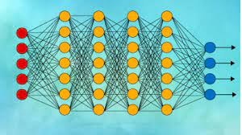
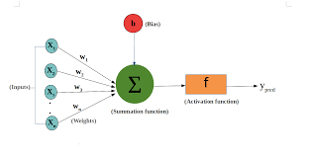
LLMs and power – Bigger not necessarily better
x
=
Billions of bits of data being calculated – moved between memory and processing
Weights, biases and intermediate values moved between memory and processing
Millions of neurons with billions of connections
More parameters => more data => more bits moved => more energy consumed
Notes:
But as we look toward a sustainable future with ecological benefit and the dual benefit of reduced operational costs based on reduced power consumption, we see that LLMs aren’t that free lunch that I mentioned earlier. LLMs like any other deep, convolutional neural network, are based on the fundamental building block of the perceptron which you see on the left. Those values (the xs) are multipied by weights summed with a bias and then sent to activation function. The Xs, Ws, Bs, and Ys at their most fundamental logical hardware level are data being moved back and forth between compute and memory. Take that one perceptron and deploys variants of that into the diagram in the middle and now for an LLM you have millions of perceptrons (to refresh is the mathematical representation of a neuron) with billion of connections. This means billions of bits of data being moved between memory and compute. More parameters means more data means more data movement and 90% of energy consumed in modern process geometries is spent on data movement so data consumption without the right energy efficient architecture can skyrocket…

Slide 7
Bigger LLMs - Diminishing returns
Source: Meta
Notes:
And despite the growth trajectory that I showed a few slides back, there is a recognition tthat the training costs and operations costs for ever growing LLMs is unsustainable - leading to research in the area of “small” LLMs which have a high degrees of accuracy and a better fit for sustainable inference at scale. This graph is showing a measure of the “multi-task language understanding” benchmark (the higher the result – the better) on the Y Axis versus model size on the X-axis. Although GPT-4 is state of the art, LLAMA-2 at 70B parameters and even smaller variants at 13B and 7B parameters are proving suitable for a variety of use cases. This is putting high performance LLMs for generative AI in grasp of high deployment…
MMLU (5-shot) - a test to measure a text model’s multitask accuracy. The test covers 57 tasks including elementary mathematics, US history, computer science, law, and more.
https://ai.meta.com/research/publications/llama-2-open-foundation-and-fine-tuned-chat-models/

Slide 8
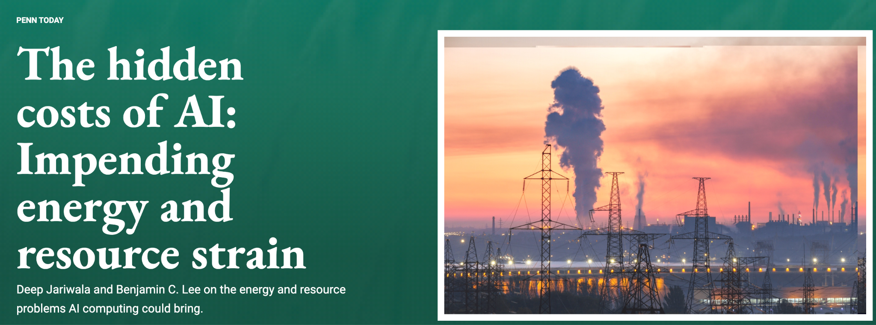
GenAI productivity at the price of sustainability?
Lee – ”As AI Products like ChatGPT and Bing become more popular, the nature of computing is becoming more inference based”
Jariwala – “We take it for granted, but all of the tasks our machines perform are transactions between memory and processors, and each of these transactions requires energy”
Van Rijmenam - ”It seems that a single prompt of ChatGPT consumes 100x more energy than a single Google Search”
Notes:
Which results the productivity gains of generative AI saddled with the unsustainable costs of energy INEFFICIENT LLM inference. In a recent paper written by Deep Jariwala and Benjamin Lee from Upen called “The hidden costs of AI”, in my opinion not so hidden, inference is increasing and with it the energy cost. In another piece written by Dr. Mark Van RYE-MEN-NAM called “BUILDING A GREENER FUTURE: THE IMPORTANCE OF SUSTAINABLE AI” he mentions that a ChatGPT prompt may consume 100 times the energy of a Google Search…
https://environment.upenn.edu/events-insights/news/hidden-costs-ai-impending-energy-and-resource-strain
https://news.climate.columbia.edu/2023/06/09/ais-growing-carbon-footprint/
https://blog.research.google/2022/02/good-news-about-carbon-footprint-of.html
https://www.thedigitalspeaker.com/greener-future-importance-sustainable-ai/

Slide 9

And movement from cloud to edge is not an energy panacea
“1 billion AVs driving 1 hour per day would consume enough energy to generate the same amount of emissions as data centers currently do”
“1 billion AVs would make 21.6 quadrillion inferences. All of Facebook’s data centers worldwide make a few trillion inferences each day “
“One way to boost that efficiency could be to use more specialized hardware…one challenge in developing specialized hardware would be to “future-proof” it so it can run new algorithms”
Source: MIT
Notes:
And this is not merely a cloud issue. Distributed compute is NOT the energy panacea. With an investor such as GM, one of our focus markets is autonomous vehicles (AVs). In an increasing electric vehicle (EV) world, battery life which equates to range is paramount. Range anxiety is still the number one challenge facing EV manufacturers. Autonomous vehicles are inference machines on wheels. In a recent MIT paper regarding AV carbon emissions, with current von Neumann based technologies, it’s estimated that 1 billion AVs at 21.6 quadrillaion inferences per day would consume enough energy resulting in the emissions as current data centers do. There is a need for energy efficient AI hardware. It is a must have. To get out of this quagmire, taking into account the flexibility of future workloads needed in the downloadable AV, the paper states the challenge as the need for specialized hardware which we very simply call energy efficient AI inference hardware…
https://news.mit.edu/2023/autonomous-vehicles-carbon-emissions-0113
https://ieeexplore.ieee.org/document/9942310

Slide 10

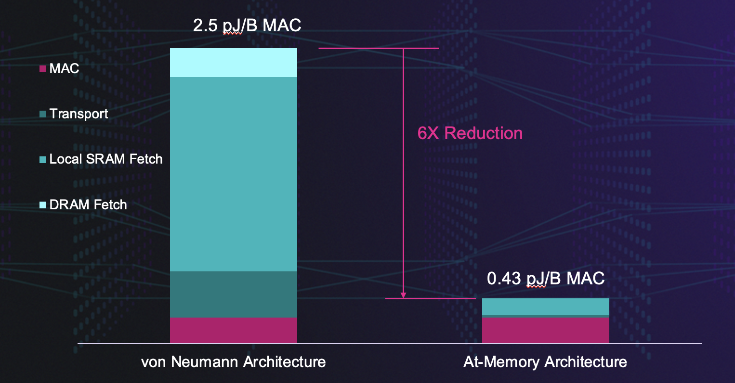
Efficiency is a First-Order Design Goal
Datacenters consume 1-1.5% of the world’s power today¹
  Generating 300 metric tons of CO2 emissions per year
  Expecting a 2-4x increase in percentage of global power by 2030²
We need a more energy centric approach to designing processors, boards, servers, and datacenters, particularly for artificial intelligence
Attack the chief culprit: data movement
  This is particularly true in neural net inference
1. International Energy Agency: Data Centres and Data Transmission Networks, 2022
2. New perspectives on internet electricity use in 2030, Anders S.G. Andrae, 2020
Notes:
Energy Efficiency must be a first order design goal. Datacenters consume one to one point five percent of the planet’s entire power generating a whopping 300 metric tons of carbon dioxide emissions annually and growing since there is an expectation that this could increase up to 4 times by 2030. This is not sustainable so as stated in the previous slide, there is a growing need for energy centric AI inference and that begins with addressing the chief culprit of energy consumption which is data movement which is exacerbated by movements between processors and mermory in large language models.

Slide 11
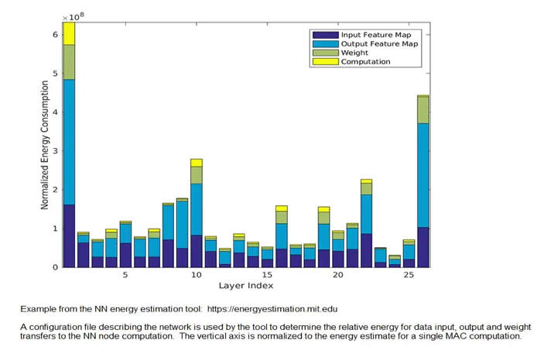
Most Energy is Spent Moving Data
A Per-Layer Breakdown of Energy Consumption in a Deep Neural Network
In GPUs/CPUs, computation is consistently a small fraction of energy expended compared to data movement
Every clock cycle spent moving data from memory introduces latency and increases power
Source for graphic: TSMC https://ieeexplore.ieee.org/document/9365766
Notes:
Here’s an interesting graphic from TSMC showing the per layer breakdown of energy consumption in a deep neural network. In von Neumann based CPUs and GPUs computation is consistently a small fraction of energy expended compared to data movement so time spent on data movement adversely impacts power and latency…
Came through TSMC. Comes from MIT. Yellow is acutal computation. Everyt8ing else is movement of data

Slide 12
Energy Centric Design – Minimize Data Movement
Data movement takes as much as 90% of all power in neural nets
Near Memory/
Von Neumann Architectures
At-Memory Computation
In-Memory Computation
D/A
Memory Cells
Cache
DRAM
SRAM
SRAM
ALU
ALU
Pipeline logic
A/D
SRAM
SRAM
Non-MAC Operations
ALU
ALU
Long, narrow busses
Deep/shared cache
Short, massively parallel direct connections
Dedicated, optimized memory for efficiency and bandwidth
Analog techniques used for MAC
Digital processors for non-MAC operations

Slide 13
Introducing speedAI Devices –The Energy-Centric AI Inference Accelerator
speedAI is the most efficient accelerator in its class
Power Efficiency
Accuracy
Scalability
Industry-best TOPs/W increases computer density and reduces cost
INT4, INT8, FP8 and FP16 datatypes enables efficiency/accuracy tradeoffs
Supports LLMs and vision transformers

Slide 14
speedAI240 – A 2,000 TFLOPs, 30 TFLOPs/W Inference Accelerator
728 Dual RISC-V memory banks provide unmatched performance and programmability
  2,015 FP8 TFLOPs
  1.35 GHz, TSMC 7nm
  1456 RISC-V processors
At-memory compute provides energy efficiency and massive bandwidth
  30 TFLOPs/W
  238 MB on-chip SRAM
  ~1 PB/s SRAM bandwidth
Scalability
  External memory support
    32 GB LPDDR5 across two x64 ports
    819 Gb/s DRAM bandwidth
  PCI-Express GEN5 connectivity
    Host and chip to chip (new!)
  Accuracy
  Multiplicity of datatypes - INT4 to FP16
    New FP8 datatype!
1MB Cache
PCIe Gen5 x8
RISC-V Chip Manager
I/O Ring NOC
PCM
PCM
PCM
PCM
PCM
PCM
PCM
Memory bank
Memory bank
Memory bank
PCM
X64 LPDDR5
E/W NOC
X64 LPDDR5
PCM
PCM
PCM
Memory bank
Memory bank
Memory bank
PCM
E/W NOC
x27
PCIe Gen5 x8
PCIe Gen 5 x8
PCM
PCM
N/S NOC
N/S NOC
x27
N/S NOC
Memory bank
Memory bank
Memory bank
PCM
PCM
1MB Cache
E/W NOC
1MB Cache
PCM
PCM
PCM
PCM
PCM
PCM
PCM
PCIe Gen5 x16
1MB Cache

Slide 15
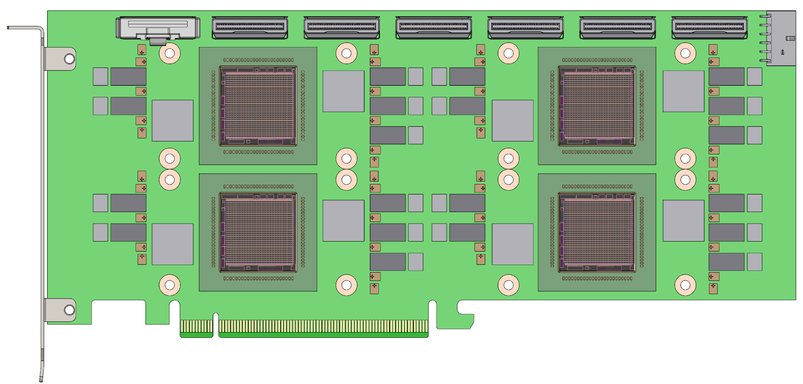
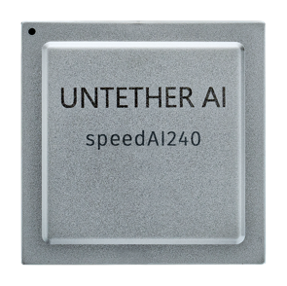
At-memory spatial architecture allows large scale at low power
1 network loaded across multiple devices – all parameters on chip minimizing data movement
.
.
.
.
.
Sub 100B parameters
Notes:
With LLMs moving to improving accuracy over smaller parameter sizes, the at-memory architecture now provides a way to scale without the cost and power associated with HBMs attached to GPUs

Slide 16


Summary
Generative AI economic impact will be massive
But at the price of energy consumption
Inference cannot afford to waste energy on data movement
LLM innovations + Minimization of data movement
= Energy efficient AI inference at scale
DRAM
Cache
Pipeline logic
SRAM
SRAM
ALU
ALU
ALU
ALU
SRAM
SRAM

Slide 17
Thank you

