Slide 1
Niagara: CXL Memory Disaggregation for HPC and AI Workloads
Hokyoon Lee (hokyoon.lee@sk.com)
Head of System Software
Memory Forest x&D
SK hynix

Slide 2
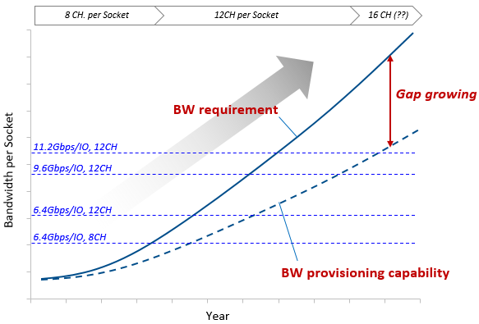
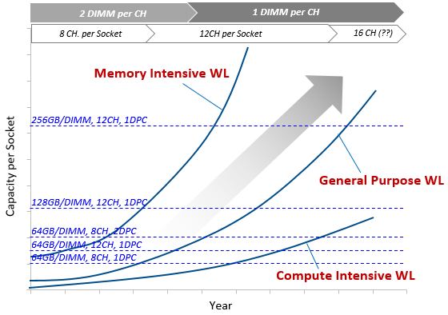
Growing Memory Bandwidth and Capacity Gap
Increase in core counts requires continued increase in memory bandwidth & capacity
The gap between such requirements and platform provisioning capability is growing
[ Memory Capacity Requirement ]
[ Memory Bandwidth Requirement ]

Slide 3
Challenges in Today’s HPC and AI Workloads
Challenge 1 : Memory stranding & data spill
  The memory utilization of each node in a compute cluster varies time to time
  Unused memory in each node can never be utilized by other nodes, which causes memory stranding and data spill
→ Memory usage of the HPC & AI workloads should fit into the memory capacity
VM 1
Core
Core
Core
Core
Core
Core
Core
Core
VM 1
Core
Core
Core
Core
Core
Core
Core
Core
VM 2
VM 2
Memory
Memory
Two sides of a coin
VM 3
VM 3
Stranded
Spilled
[ Memory Underutilization & Wates of memory costs ]
[ Storage swap & Performance degradation ]

Slide 4
Challenges in Today’s HPC and AI Workloads
Challenge 2 : Data transfer overhead & data duplication
  In distributed computing system, there is network-based data transfer overhead between remote nodes
  Duplication of shared data between nodes increase local memory pressure
Require hard works in software design to exploit the decoupled compute & memory resources
Node
Node
Network
App
App
DRAM
DRAM
High-speed/High-cost NIC
Network SW Stack overhead
Data Duplication
Node
Node
App
App
DRAM
DRAM

Slide 5
Memory Disaggregation: Pooling & Sharing
Memory pooling : Mitigate memory stranding and data spill by sharing memory resources
Memory sharing : Remove data transfer overhead and data duplication by sharing data
[Memory Pooling]
[Memory Sharing]
Disaggregated Memory (Resource Sharing)
Disaggregated Memory (Data Sharing)

Slide 6
Opportunity Created by CXL Interconnect
CXL creates new opportunities beyond physical limitations, and efficient memory disaggregation is possible
Composable Disaggregated Infrastructure (CDI)
  Utilizes management software to combine compute, storage and network elements
  Consists with disaggregated resource pools of Compute (CPU), Storage, GPU, and Memory
[ Fixed Configuration Infrastructure ]
[ Composable Disaggregated Infrastructure ]

Slide 7
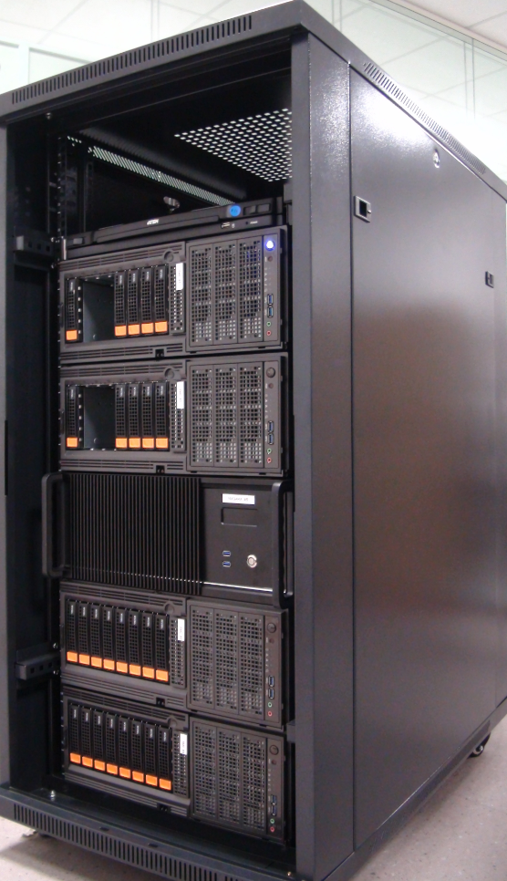
Our Solution: Niagara - CXL Disaggregated Memory
Niagara is a 2U FPGA based multi-port CXL disaggregated memory prototype
  Up to 8 CXL host servers can be connected, Support up to 4 channels of DDR4 DIMM (Up to 1TB)
  Support memory pooling, sharing and other HW-assisted features
CXL Interface | CXL 2.0, Gen4x8
 | Up to 8-port
Memory | 4CH DDR4 DIMM
 | Up to 1TB
Performance | Latency : 600ns
 | Bandwidth : 11GB/s
Server
#1
Server
#2
Server
#3
Server
#4
Server
#5
Server
#6
Server
#7
Server
#8
CXL RP
CXL RP
CXL RP
CXL RP
CXL RP
CXL RP
CXL RP
CXL RP
Server #1
CXL Link
Server #2
CXL EP
CXL EP
CXL EP
CXL EP
CXL EP
CXL EP
CXL EP
CXL EP
Niagara
Dynamic
Allocation
Engine
Memory Protection
Unit
Server #3
Memory
Memory
Memory
Memory
Server #4
[ Niagara Specification ]
[ Niagara Block Diagram ]
[ Rack-scale VM Cluster with Niagara ]

Slide 8
Use Case1: Memory Pooling
Niagara can dynamically allocate/deallocate disaggregated memory resources for each node without RESET
Improve memory utilization and performance of the system equipped with CXL disaggregated memory
Controller Node
Compute Node
Request/Release
Memory
VM
Cluster Manager
(VM Scheduler)
Schedule VM
Host VM
Manager
Memory Pooling
Daemon
Resizing Memory
via virtio-mem
Local Memory
CXL Pooled Memory
Resizing Memory
via DCS
Create VM
2M
2M
2M
2M
Dynamic
Request VM
2M
2M
2M
Client
DCS Library
Virt Library
Virtio-mem
Kernel
CXL Driver
KVM/QEMU
Hypervisor
Local Memory
CXL Pooled Memory
DRAM
2GB
2GB
2GB
Dynamic
CXL Command
Dynamic Capacity Service (DCS)
Niagara
CXL EP
CXL EP
CXL EP
CXL EP
Dynamic
Allocation
Engine
Memory Protection
Unit

Slide 9

Use Case1: Memory Pooling - Evaluation
Reduce execution time by mitigating data spill and improve memory utilization of system
 | Baseline Kubernetes |  | DCS-enabled Kubernetes
 | Worker Node #1 | Worker Node #2 | Worker Node #1 | Worker Node #2
# CPU Cores | 112 | 176 | 112 | 176
Local Memory Capacity | 62 GB | 62 GB | 62 GB | 62 GB
CXL Memory Capacity | 32 GB | 32 GB | 64 GB (Pooled)
Total Memory Capacity | 94 GB | 94 GB | 62-126 GB | 62-126 GB
Avg. Memory Utilization | 55.7% |  | 75.1%
2.5x improvement
35% improvement
[ Execution Time of In-memory Analytics Workload¹ ]
[ Memory Utilization on Kubernetes² ]
1) Collaboration with
2) M. Ha et al., "Dynamic Capacity Service for Improving CXL Pooled Memory Efficiency,“ IEEE Micro, 2023

Slide 10
Use Case2: Memory Sharing
Niagara supports firmware that allows all hosts to access the Niagara as data shared memory
No more object serialization and transfer over network for remote object access
No more duplicate object copies on different nodes → Zero copy
Node #1
Node #2
Node #3
Node #4
CXL RP
CXL RP
CXL RP
CXL RP
Data Write
Data Read
Data Read
Data Read
CXL EP
CXL EP
CXL EP
CXL EP
Pooled Memory
Manager
Shared Object

Slide 11
Use Case2: Memory Sharing - Evaluation
Reduce execution time by eliminating network based data transfer overhead
5.9x improvement
1.8x improvement
[ Execution Time of Ray¹ Shuffle Benchmark² ]
[ Execution Time of Spark Benchmark ]
Ray is an open source based distributed computing framework for AI/ML
Collaboration with

Slide 12
HW-assisted Features of Niagara
Niagara supports HW-assisted features to CXL disaggregated memory efficiency
  Block Data Management : Copy or move the data within CXL pooled memory
  Snapshot : Save and restore the data in CXL Pooled Memory to/from storage device
  Memory Failure Prediction : Predict memory Uncorrectable Errors(UEs) by analyzing memory failure patterns
Node #1
Node #N
Node #1
Node #N
Node #1
Node #N
CXL RP
CXL RP
CXL RP
CXL RP
CXL RP
CXL RP
CXL EP
CXL EP
CXL EP
CXL EP
Notify predicted UE
CXL EP
CXL EP
UE prediction
Pooled Memory
Manager
Data
Copy/Move
Pooled Memory
Manager
Data
Save/Restore
Pooled Memory
Manager
CXL Disaggregated Memory
CXL Disaggregated Memory
Storage
CXL Disaggregated Memory
[ Block Data Management ]
[ Snapshot ]
[ Memory Failure Prediction]

Slide 13
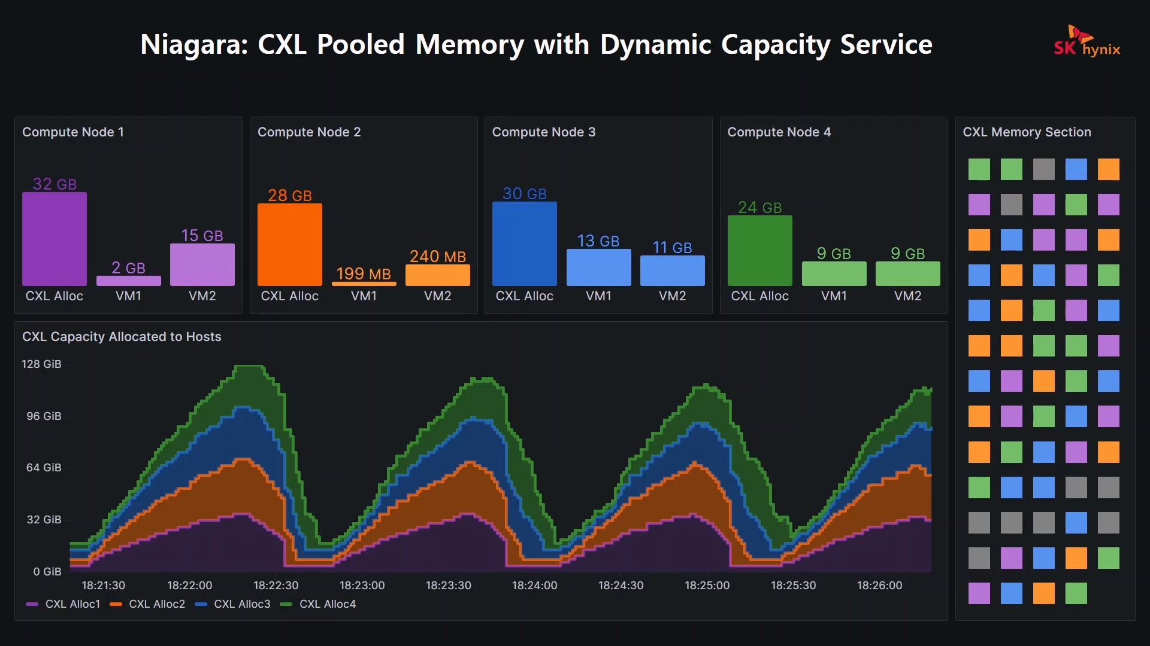
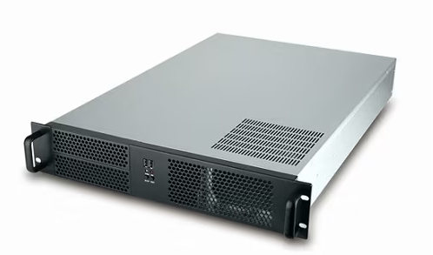
Niagara Exhibition in SK hynix booth #2101
Demonstrating the operation of allocation/deallocation CXL disaggregated memory capacity based on changes in memory requirements of the VM servers
[ Niagara CXL Pooled Memory]
[ Memory Pooling Demo ]

Slide 14
Lesson Learned
Infrastructure software such as Openstack and Kubernetes are unaware of the disaggregated memory resource
  Need to enumerate/monitor/manage the disaggregated memory resource
Linux Kernel is not ready to fully utilize the DCS (or DCD) feature of CXL disaggregated memory
  The granularity of allocating/releasing is fixed size of 128MB or 2GB
  Offlining of the memory section fails frequently because there are lots of live pages to be migrated on release
Software has responsible for managing data coherency & consistency to use the shared memory
  Host CPU and the memory should support snoop filter and back-invalidation mechanism from CXL3.0 specification
Conventional distribute computing platform (e.g., Spark) has been designed well for parallel computing

Slide 15
Future Works
Performance
  Memory Sharing: Develop a HW based synchronization mechanism to eliminate SW communication overhead
  2-Tier memory management: Hot/Cold page detection & migration
Scalability
  Switch-based CXL Pooled Memory architecture & software
  Research on the efficient way for Rack-to-Rack communication
Durability
  Pooled Memory Manager: Develop a cluster management SW (Self-testing, self-healing, error monitoring)
  Memory Failure Prediction: Support various memory media such as DDR4/DDR5

