Slide 1
The Cost of Flexibility and Security in Cloud-Based HPC
A Case Study Running EDA Workloads With Confidential Computing Technology
Derren Dunn (dunnderr@us.ibm.com), Mengmei Ye (mye@ibm.com), Daniele Buono, Angelo Ruocco, Scott Guthridge, Claudio Carvalho, Tobin Feldman-Fitzthum, Frank Schmuck, Vasily Tarasov, Hubertus Franke, James Bottomley
IBM Research

Slide 2
Disclaimer
This work represents the view of the authors and does not necessarily represent the view of IBM.
The features described may not ultimately exist or take the described form in a product.
IBM is a registered trademark of International Business Machines Corporation in the United States and/or other countries. Other company, product, and service names may be trademarks or service marks of others.

Slide 3
Why consider cloud for Electronic Design Automation (EDA)?
Opportunities addressable by internal datacenters and license
Opportunities addressable by cloud bursting and peak license strategies
compute
licenses
compute
Possible opportunities
licenses
Possible opportunities
Fully resourced opportunities
Fully resourced opportunities
On-prem resources force prioritization
Leave unrealized opportunities
Easily expand addressable opportunities:
  Public cloud bursting
  Leveraging peak license strategies
people
people
4 major problems for enabling EDA flows in hybrid clouds
Security – process design kits (PDKs), intellectual properties (IPs), new design escape liability is often uncapped
Data hydration/migration – Difficult to get initial data required into cloud, pay premium to move back
Cloud filesystems - Difficult to build a filesystem in the cloud without oversubscribing block storage, network, etc.
Configuration - VSI clusters, job management, storage, and license flows requires significant cost prior to useful cycles

Slide 4
Focus of our talk
Validate that cloud native can be effective
  On-prem-like scalability
  Ease of deployment - better flexibility than batch scheduling
Validate that cloud native can be secure AND performant
  Confidential computing: data protected at-rest, in-motion and in-use
  No need to trust deployment and control plane
EDA workloads are not unique and resemble other HPC workloads/applications
  Finance/banking
  Healthcare
  Government workloads

Slide 5


EDA Typical Design Flow
RTL
RTL
Synthesis
High-value
Assets & Data
Multiple stages involving different tools
Large storage requirement
  PDKs and cell libraries (>1TB): read only
  Tool installation (~500GB or more): read only
  User workspace (>1TB per project): read and write
    Different nodes read and write in the same file system
Single established design flow is applied to multiple macros and units
Characteristics of the workloads:
  HPC-like requirements
    1,000’s to 10,000’s CPUs
    High speed network and shared storage
  PDKs and (IPs) are high-value assets
The cost of a leaked proprietary design is measured in millions of dollars, loss of competitiveness and brand damage
PDKs
Floorplanning
Libraries
Placement
Library
Clock Tree Synthesis
Intermediate Design Products
Library
Routing
Product
Designs
Timing Closure
Library
DFM, Fill
DRC/LVS
ERC
Physical Verification
Lithography Masks
Library
OPC/ORC
Tape-out
*Figure adapted from: Kahng et al., VLSI Physical Design, Springer, 2011

Slide 6


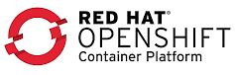
EDA cloud burst example
Focus of this talk -
Near future: Cloud-native deployment on K8s/OpenShift (any cloud) with confidential containers
EDA workflow
Cloud deployment today
(Can support confidential VMs)
RTL
RTL
High-value
Assets & Data
LSF cluster in VPC
K8s/OpenShift cluster
Synthesis
PDKs
Floorplanning
Workload scheduled using on-prem tools (LSF)
No change to current on-prem tools and jobs, ready to use
Well-known performance profile
Nodes virtualized through standard VMs
Burden of configuring a new HPC cluster on the client
Workload defined and scheduled using cloud-native tools, which reduces time/cost to useful compute cycles
Burden of configuring a new HPC cluster on the cloud provider
Scale-up flexibility
Tools and configurations stored in container registries
  Easier deployment – less setup and configuration
  Multi-cloud capabilities
Libraries
Future
Library
Placement
Today
Intermediate Design Products
Clock Tree Synthesis
Library
Routing
Product
Designs
Library
Timing Closure
Lithography Masks
DFM, Fill
DRC/LVS
ERC
Physical Verification
Library
Tape-out
OPC/ORC
(Encrypted) Network FS
6
*EDA workflow figure adapted from: Kahng et al., VLSI Physical Design, Springer, 2011

Slide 7
EDA use case: Siemens Calibre®
“Classic” Primary/Worker HPC pattern
Parallel distributed memory application
OPC distributed runs:
  Primary pod/process divides layout into tiles
  Parses tiles out to processes on remote (worker) pods/processes
  Completed tiles written to common filesystem
  Tiles distributed until layout complete
  Primary pod/process reads from common file system and assembles final output
Worker 1
(rcalibre)
Worker 2
(rcalibre)
Primary
(calibre®)
……
Worker N
(rcalibre)

Slide 8
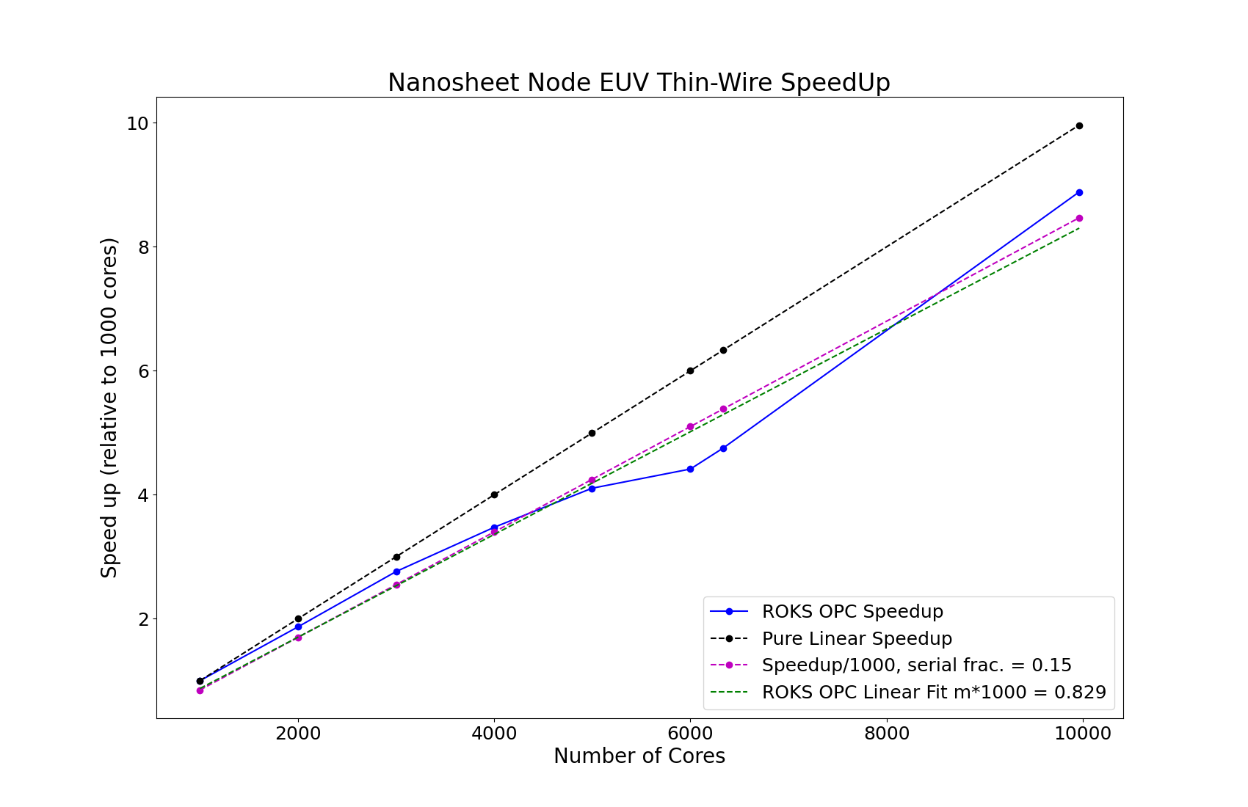
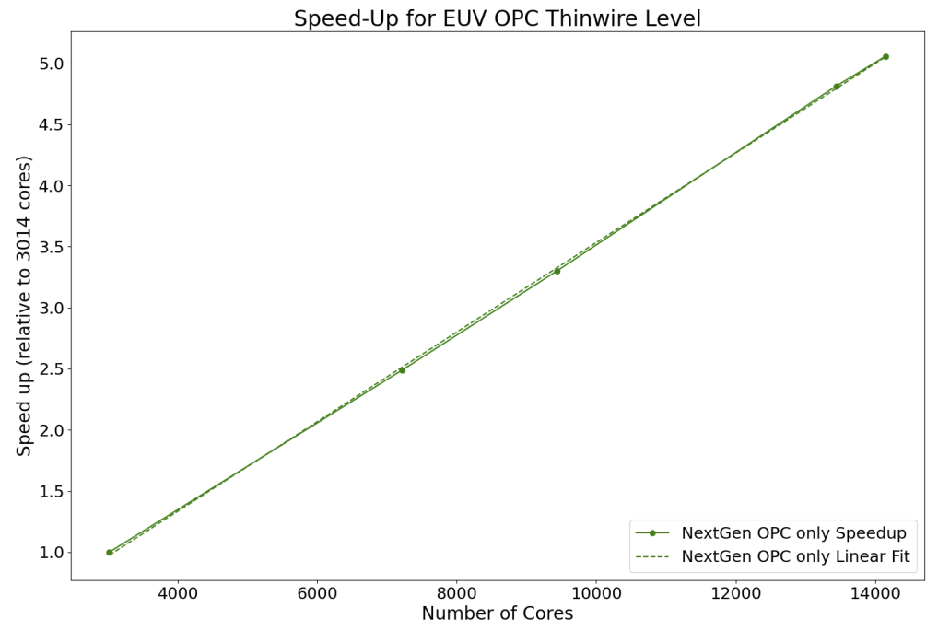
Non-confidential cloud EDA bursting
Comparable workload performance to on-prem infrastructure in public clouds
Linear speed up for an EDA workload (OPC) in both Virtual Machines (VSI) and OpenShift-based clusters (ROKS)
  VPC VSI’s: Demonstrated scaling to 14,000+ physical cores in IBM Cloud using Synopsys proteus® OPC tools
  IKS/ROKS: Demonstrated to 10,000 cores using Siemens Calibre® DRC/OPC tools
Moved internal workloads: Albany Nanotech mask data prep running in IBM Cloud (both Synopsys proteus® and Siemens Calibre® toolsets)
Workload scaling on IBM Cloud VSI’s w/ Synopsys proteus® tools
(5 nm and beyond node EUV thin-wire OPC)
Workload scaling on IBM Cloud ROKS w/ Siemens Calibre® tools
(Siemens Calibre® OPC)
https://www.ibm.com/downloads/cas/DNJZOQXG
https://kubernetesbatchdayna22.sched.com/event/1AsSa/hybrid-cloud-bursting-electronic-design-analysis-optical-proximity-correction-opc-flows-to-public-cloud-managed-kubernetes-services-derren-dunn-ibm-gaurav-singh-red-hat

Slide 9
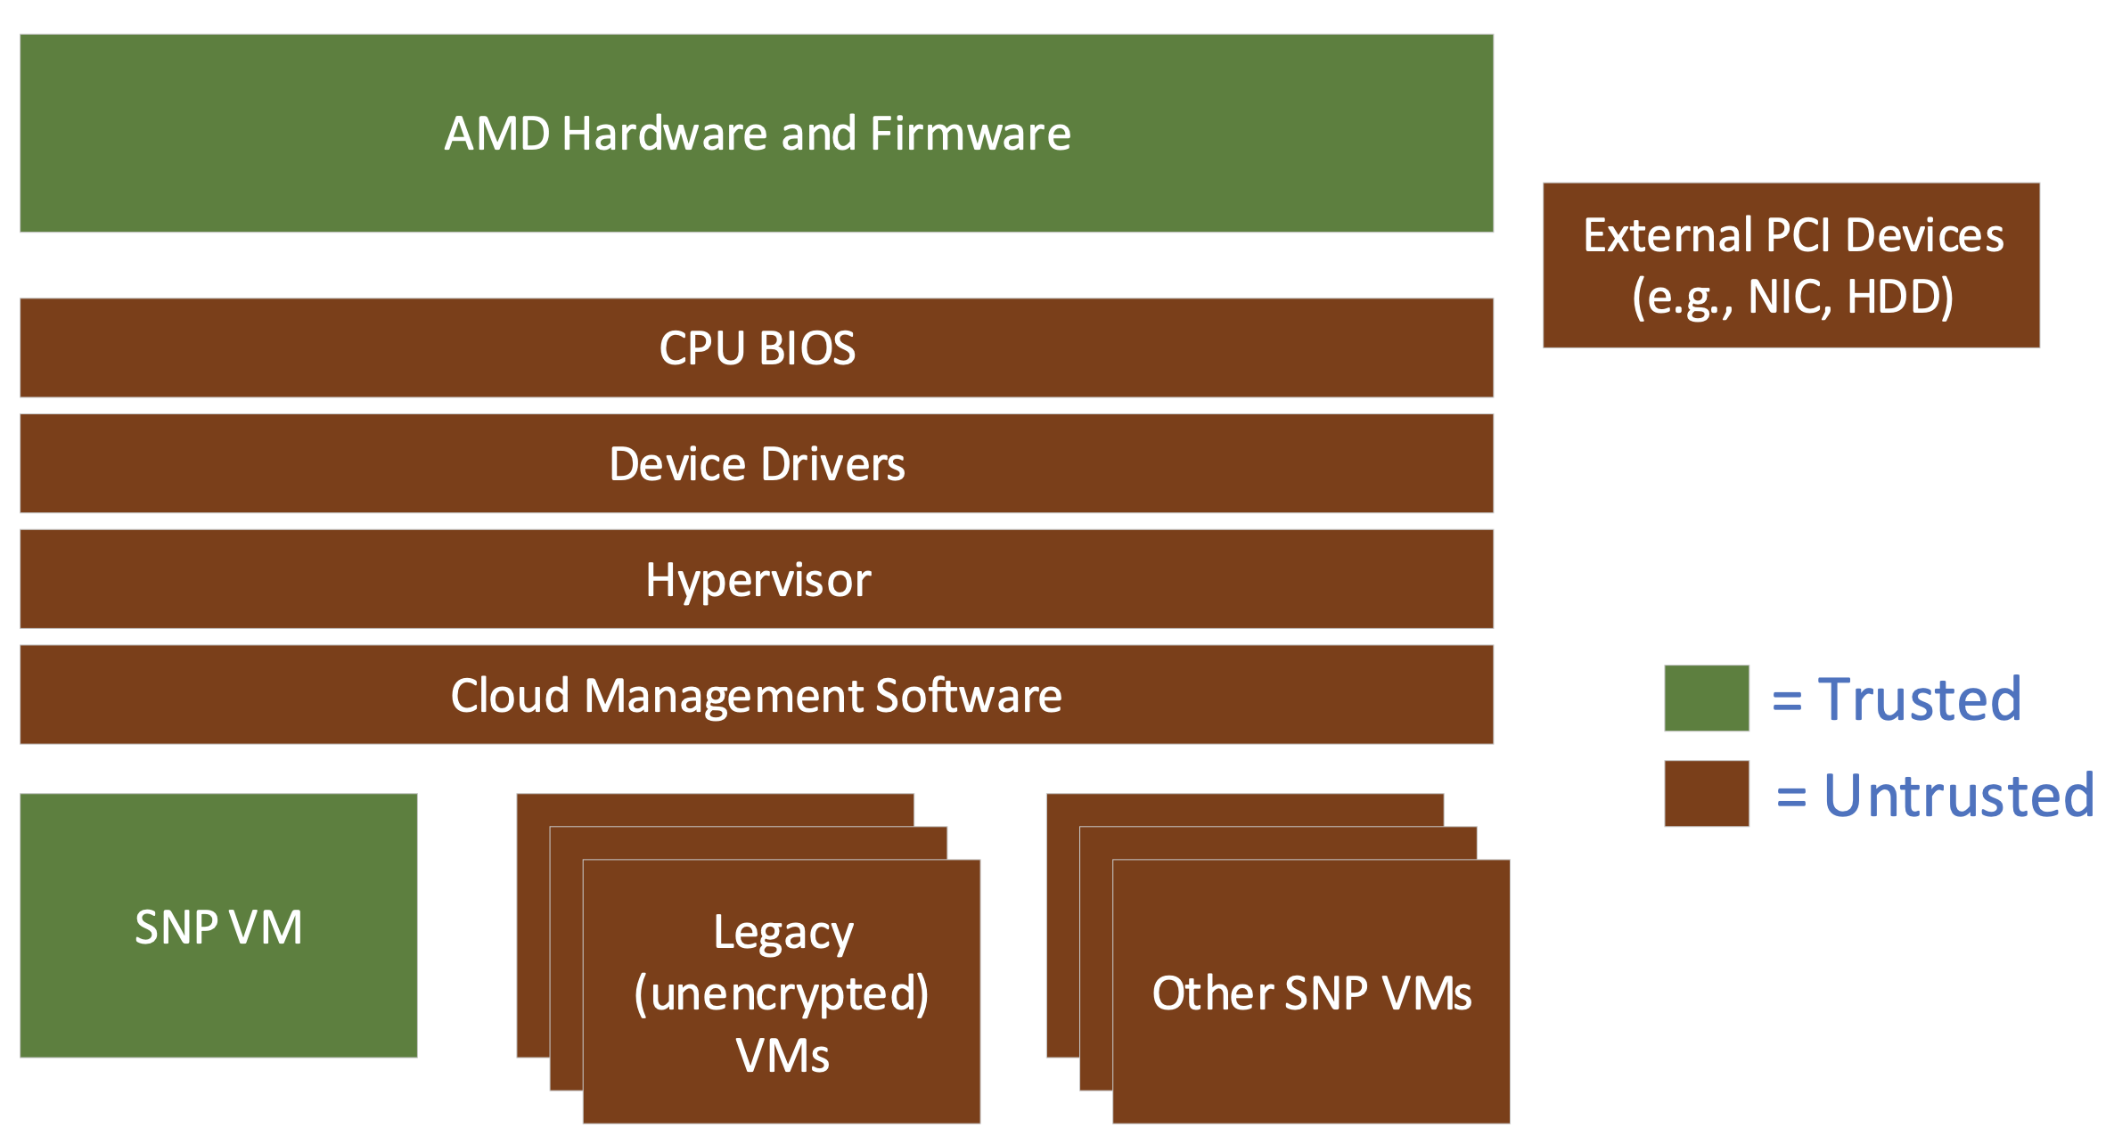
What security mechanisms are available today
Data at rest
  Secure storage with file- or block- level encryption
Data in motion
  Virtual Private Networking (VPN): secure communications through encrypted VPN tunnels
Data in use/compute (confidential computing)
  Memory is encrypted
  Process based trusted execution environment (TEE): Intel SGX
    Need to modify applications deployed in the systems
  VM based TEE:
  AMD SEV, Intel TDX, IBM Z Secure Execution, etc.
    Larger TCB but no need to changes to applications
Security requirements
  Data should only be decrypted inside of enclaves – i.e. encrypted VMs
  CSPs, hypervisors should have no code running inside of enclaves
Image source – AMD SEV-SNP: Strengthening VM Isolation with Integrity Protection and More, January 2020, White Paper.

Slide 10


Confidential Containers (CoCo): Cloud-native confidential computing technology
Why CoCo
  Cloud Native Computing Foundation Sandbox project based on Kata Containers: github.com/confidential-containers
  IBM community leadership, IBM has contributed over 100 PR’s and over 1000 Github contributions
  Steering committee: IBM (Z and Research), Red Hat, Microsoft, Alibaba, AMD, Intel, ARM, NVIDIA, Rivos
  Each pod is encapsulated in a confidential/encrypted VM
  Each container image must be pulled and decrypted within the enclave since the host must not get inside of the image
  Small interface (Kata Agent) sets up the pod inside the VM
Kubelet
Container
Image
Container
Image
Confidential VM
Attestation
Agent
Key Broker
Service
Containerd
Kata Agent
KVM
Kata Runtime
VMM

Slide 11

Challenges of running a secure end-to-end EDA workflow in cloud
Security challenge
  Standard security solutions for storage and networks require host involvement, but the host is not trusted in the CoCo framework
  Any sensitive data can only be decrypted inside of CoCo
Performance challenge
  What is the scalability of these security solutions? What is the performance overhead with CoCo + Secure Storage + Secure Network?
CoCo 1
CoCo 2
Encrypted file system
CoCo 3
K8s

Slide 12
EDA with CoCo
Host
K8s setup
  1 control plane + 28 worker nodes (1736 cores in total)
  2 pods per node (56 pods in total)
  Each worker node supports AMD SEV-based CoCo
Siemens Calibre® workloads are running in CoCo
  Memory is encrypted
  Unencrypted data is only inside of confidential VMs
Kubernetes Control Plane runs on the host and is not trusted
Experimental baseline: a k8s cluster running on bare-metal machines
Container/Kata/CoCo
1
Shared Storage
Container/Kata/CoCo
2
K8s
Pod-centric Virtualization
(Kata – Classic VMs)

Slide 13
EDA with CoCo
Performance improvement by mounting shared storage into CoCo as a sidecar
  From 8.03% to 6.67%
  Eliminate Host<->VM disk overhead
Host
Host
CoCo 1
Container/Kata/CoCo
1
Storage Container
Shared Storage
Container/Kata/CoCo
2
CoCo 2
Storage Container
K8s
K8s

Slide 14

EDA with CoCo + Secure Storage
Secure storage: encrypt PDK data by persona, derivative design data, etc.
Based on GPFS, transparent encryption layer for NFS and other FS, etc.
  Generic Sidecar for Encrypted File System layer (gocryptfs, fuse-based)
  Bring-Your-Own-Sidecar for customized, non open-source solutions (e.g., GPFS)
CoCo + NFS + Gocryptfs (nuetzlich.net/gocryptfs)
  6.9% performance overhead in total
Host sees ciphertext:
CoCo sees plaintext:
Host
CoCo 1
Gocryptfs
Storage Container
CoCo 2
Gocryptfs
Storage Container
K8s

Slide 15
EDA with CoCo + Secure Storage + Secure Network
Any data leaving CoCo must be encrypted
Generic Sidecar for mTLS encrypted network traffic through ISTIO’s Envoy
CoCo + NFS + Gocryptfs + Envoy (i.e., CoCo - E2E)
  7.13% performance overhead in total
Host
CoCo 1
Gocryptfs
Storage Container
Envoy
Envoy
CoCo 2
Gocryptfs
Storage Container
K8s

Slide 16
Conclusion and Future Work
We demonstrated how to securely run end-to-end cloud-native EDA workloads
  Security: Integrated the data-in-use protection of Confidential Containers with secure private/shared storage and network
  Performance: ~7% overhead for encryption at-rest, in-motion and in-use
    Moderate scale: 1736 cores, 28 nodes
  Similar setup can extend to other parallel distributed HPC applications
    Primary/Worker pattern analyzed here
Future work
  Extend use cases to generic HPC and AI workloads
    Other communication patterns such as data-parallel
  Advanced secure storage and network implementations to reduce performance overhead at large scale

