Slide 1
Compute Express Link™ (CXL™): Advancing Coherent Connectivity ​
Kurt Lender
CXL Consortium Marketing Work Group Co-Chair

Slide 2
















CXL Board of Directors
Industry Open Standard for
High Speed Communications
255+ Member Companies

Slide 3
CPUs/GPUs
CXL Ecosystem
Memory Solutions
Accelerators/
FPGAs
Growth of CXL ecosystem since its inception
Ecosystem that meets the
ever-increasing performance and scale requirements
Software
Solutions
CXL IPs
Fully backwards compatible
Lower overall system cost
Analyzers/
Traffic Generators
Memory Expanders
Switches
Comprehensive compliance and testing support

Slide 4
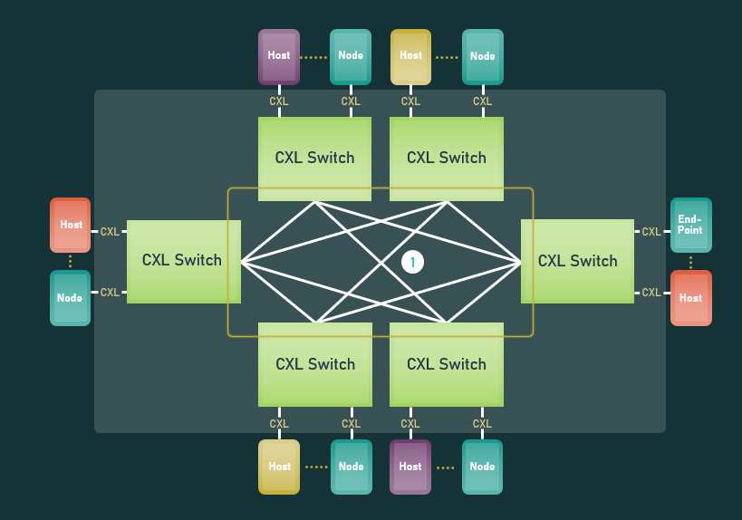






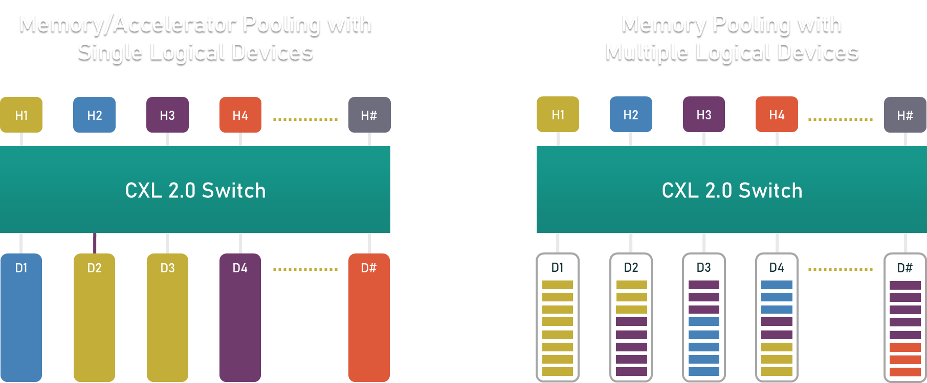
Data Center: Expanding Scope of CXL
Wireless
Interconnect
Mobile
Networks
Router
Inter DC links
Core/Edge
Network
WAN
CXL 3.0/3.1
Spine Switch
Leaf Switch
DATA CENTER
TOR Switch
Composable Fabric growth for disaggregation/pooling/accelerator
Data center
Interconnect
RACK
RACK
RACK
RACK
RACK
RACK
RACK
CXL 1.1
Single Node
Coherent interconnect
Processor
Interconnect
NODE
CXL 2.0
PACKAGE
SoC
Interconnect
DIE
Multiple Nodes inside a Rack/ Chassis supporting pooling of resources
Notes:
CXL 2.0 = scale out
CXL 3.0 = scale up

Slide 5
Representative CXL Usages
Caching Devices / Accelerators
Accelerators with Memory
Memory Buffers
TYPE 1
TYPE 2
TYPE 3
DDR
Processor
DDR
Processor
DDR
Processor
DDR
DDR
DDR
CXL
CXL
CXL
PROTOCOLS
PROTOCOLS
PROTOCOLS
CXL.io
CXL.cache
CXL.io
CXL.cache
CXL.memory
CXL.io
CXL.memory
Accelerator
NIC
HBM
Accelerator
Memory Controller
Memory
Memory
Memory
Memory
Cache
HBM
Cache
USAGES
USAGES
USAGES
PGAS NIC
NIC atomics
GP GPU
Dense computation
Memory BW expansion
Memory capacity expansion
Storage class memory

Slide 6
CXL Specification Release Timeline
March 2019
September 2019
November 2020
August 2022
November 2023
CXL 1.0 Specification Released
CXL Consortium Officially Incorporates
CXL 1.1 Specification Released
CXL 2.0 Specification Released
CXL 3.0 Specification Released
CXL 3.1 Specification Released

Slide 7
CXL Specification Feature Summary
Features | CXL 1.0 / 1.1 | CXL 2.0 | CXL 3.0
Release date | 2019 | 2020 | August 2022
Max link rate | 32GTs | 32GTs | 64GTs
Flit 68 byte (up to 32 GTs)
Flit 256 byte (up to 64 GTs)
Type 1, Type 2 and Type 3 Devices
Memory Pooling w/ MLDs
Global Persistent Flush
CXL IDE
Switching (Single-level)
Switching (Multi-level)
Direct memory access for peer-to-peer
Enhanced coherency (256 byte flit)
Memory sharing (256 byte flit)
Multiple Type 1/Type 2 devices per root port
Fabric capabilities (256 byte flit)
Not Supported
Supported

Slide 8
Introducing the
CXL™ 3.1 Specification

Slide 9
CXL Specification Release Timeline
March 2019
September 2019
November 2020
August 2022
November 2023
CXL 1.0 Specification Released
CXL Consortium Officially Incorporates
CXL 1.1 Specification Released
CXL 2.0 Specification Released
CXL 3.0 Specification Released
CXL 3.1 Specification Released

Slide 10
CXL 3.1 Feature Enhancements
The CXL specification continues to evolve to meet new usage models
New features introduced in the CXL 3.1 specification:
  CXL Fabric Improvements/Extensions
    Scale-out of CXL fabrics using PBR (Port Based Routing)
  Trusted-Execution-Environment Security Protocol (TSP)
    Allows for Virtualization-based Trusted Execution Environments (TEEs) to host Confidential Computing Workloads
  Memory Expander Improvements
    Up to 34-bit of meta data and RAS capability enhancements

Slide 11
CXL 3.1: Fabric Enhancement Features
Port-Based Routing (PBR) compared to Hierarchy-Based Routing (HBR)
Support fabric topologies other than tree topologies that HBR switches offer
Address-based, non-prescriptive routing for large memory fabrics
Supports tree, mesh, ring, star, butterfly, and multi-dimensional topologies
Host
Host
Host
Host
CXL PBR Switch
CXL PBR Switch
CXL PBR Switch
Host
Host
CXL
CXL HBR Switch
Type-1/2/3
CXL Device
Type-1/2/3
CXL Device
Type-1/2/3
CXL Device
Type-1/2/3
CXL Device
Host
Host
Host
Host
CXL HBR Switch
CXL HBR Switch
CXL HBR Switch
CXL PBR Switch
CXL PBR Switch
Type-3
CXL Mem
Type-3
CXL Mem
Type-3
CXL Mem
Type-3
CXL Mem
Type-3
CXL Mem
Type-3
CXL Mem
Type-1/2/3
CXL Device
Type-1/2/3
CXL Device
Type-1/2/3
CXL Device
Type-1/2/3
CXL Device
Notes:
HBR is classic switch routing – where the host(s) communicates to all the devices underneath the tree. However, the host(s) cannot talk to each other and neither can the devices.
While, PBR allows for communication between the ports (hosts or end-point).
PRB (Port Base Routed) switch allow for switch topologies beyond 2.0 single layer HBR switches.
Global Fabric Device (G-FAM device ) Global Fabric Attached Memory
GIM Global Integrated Memory address space allows for multiple Host and Multiple Fabric Attached Memory to share address spaces.

Slide 12

CXL 3.1 Trusted Security Protocol (TSP)
Allows for Virtualization-based, Trusted Execution Environments (TEEs)
to host Confidential Computing Workloads (CC WL)
Key Capabilities:
Separation between TVM* & CSP’s infrastructure (VMM)
Configuration of CXL device
Encryption of sensitive data in both Host/Device memory
Cryptographically verify correct configuration of trusted
computing environment
Benefits:
Freedom to migrate sensitive WLs to TSP-enabled Clouds
Collaboration with multiple parties for sharing data
Conform to Compliance & Data sovereignty programs
Strengthen Application security & Software IP protection
VM
Host
Mem
MC
VM
CXL.io
CXL.io
MC
Device
Memory
VM
CXL Link
Host Mem
Device Memory
VM
CXL.mem
CXL.mem
TVM*
CXL IDE
(Defined in CXL v2.0)
TEE Capable Host
CXL Device
*TVM = Trusted VM
Notes:
Speaker notes:
Integrity and Data Encryption (CXL IDE) – data at flight encryption
expand re data encryption
Security extends to CXL Switch as well
Protect platforms against physical attacks and sophisticated hardware attacks on platform interconnects
Provides Confidentiality, Integrity and Replay protection for data transiting the CXL link
The cryptographic schemes aligned with current industry best practices
Supports a variety of use models while providing for broad interoperability.
CXL IDE can be used to secure traffic within a Trusted Execution Environment (TEE) that is composed of multiple components.
Maintains high performance while maintaining flexibly for security

Slide 13
CXL Specification Feature Summary
Features | CXL 1.0 / 1.1 | CXL 2.0 | CXL 3.0 | CXL 3.1
Release date | 2019 | 2020 | August 2022 | November 2023
Max link rate | 32GTs | 32GTs | 64GTs | 64GTs
Flit 68 byte (up to 32 GTs)
Flit 256 byte (up to 64 GTs)
Type 1, Type 2 and Type 3 Devices
Memory Pooling w/ MLDs
Global Persistent Flush
CXL IDE
Switching (Single-level)
Switching (Multi-level)
Direct memory access for peer-to-peer
Enhanced coherency (256 byte flit)
Memory sharing (256 byte flit)
Multiple Type 1/Type 2 devices per root port
Fabric capabilities (256 byte flit)
Fabric Manager API definition for PBR Switch
Host-to-Host communication with Global Integrated Memory (GIM) concept
Trusted-Execution-Environment (TEE) Security Protocol
Memory expander enhancements (up to 34-bit of meta data, RAS capability enhancements)
Not Supported
Supported

Slide 14
CXL @ SC’23

Slide 15
CXL at Supercomputing
CXL at SC’22:
  Showcased 12 live demonstrations of CXL at SC’22
  Demos showcase memory solutions, IP, compliance and testing, fabric switch and software solutions
CXL at SC’23:
  Showcasing 16 live demonstrations of CXL
  Demos showcase memory solutions, fabric implementations, interoperability and compliance testing, and software solutions.

Slide 16
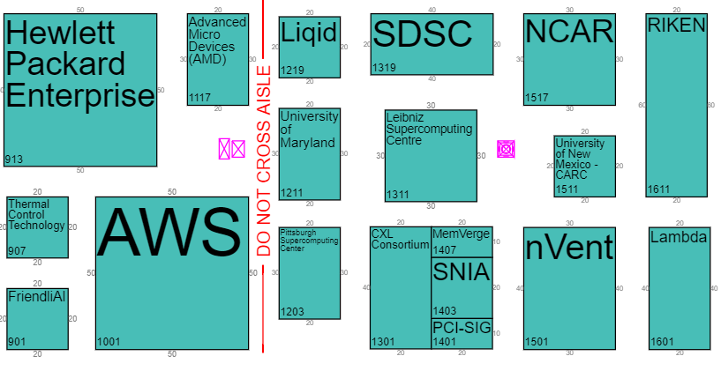

CXL @ SC’23
Visit the CXL Pavilion (Booth #1301) to view 16 live CXL technology demos
Learn more about CXL demos by scanning this QR Code:

Slide 17








View CXL Demos in the CXL Pavilion (Booth #1301)
Live CXL Technology Demonstrations
Enhancing AI with CXL Memory Tiering
Demonstrating Breakthrough Memory Bandwidth and Performance for HPC and AI with Leo Memory Connectivity Platform
CXL Memory Modes on Future Generation Intel Xeon CPUs
HP Memory Capacity & Bandwidth Expansion
Composable and Managed CXL Fabric Demo
Photowave: Optical CXL Interconnect for Composable Data Center Architectures
Silicon-Proven Subsystem IP for CXL Host and Endpoint from Cadence Live Demo with Viavi Protocol Analyzer
Micron CZ120 Memory Capacity Expansion for AI & HPC Workloads Using CXL

Slide 18









View CXL Demos in the CXL Pavilion (Booth #1301)
Live CXL Technology Demonstrations
CXL Tiered Memory Platform Development Kit for Performant Memory Scaling
Graph DB Application on CXL Memory Enabled System
CXL 2.0 Interop and Compliance Testing with Teledyne LeCroy Summit Z516 Protocol Exerciser
CXL 2.0 Memory Pooling (Sharing) Using Xconn Switch
MAXimize HPC and AI Speed with: MAX™ memory and Storage Machine
CXL 2.0 Exerciser and Analyzer System
CXL Performance Optimization & Validation SW Development Kit
Hardware Accelerated CXL Memory Compression

Slide 19
Learn More!

Slide 20

CXL Resources
Resource Library
Webinars
White Papers
Videos
Presentations
Educational blogs
Technical Training
CXL 1.1 Technical Training | Compute Express Link
CXL 2.0 Technical Training | Compute Express Link

Slide 21



Summary
The CXL 3.1 specification is now available!
Visit the CXL Pavilion (Booth #1301) to view CXL technology demos
  SC’23: 16 live CXL demos
Learn more about CXL demos by scanning this QR Code:
Join the CXL Consortium as a Contributor member and get involved!
Contact info@computeexpresslink.org if you have any questions.
@ComputeExLink
www.linkedin.com/company/cxl-consortium/
CXL Consortium Channel

Slide 22
www.ComputeExpressLink.org

Slide 23
RECAP: CXL 3.0: POOLING & SHARING
H1
H2
H3
H4
H#
S1 Copy
S2 Copy
S1 Copy
S1 Copy
1
Expanded use case showing memory sharing and pooling
CXL Fabric Manager is available to setup, deploy, and modify the environment
S2 Copy
S3 Copy
S3 Copy
CXL Switch(es)
1
2
Standardized CXL Fabric Manager
2
D1
D2
D3
D4
D#
S2
S1
S3

Slide 24

RECAP: CXL 2.0 Security Benefits
CXL 2.0 provides Integrity and Data Encryption of traffic across
all entities (Root Complex, Switch, Device)
Area of Protection
CPU/SoC Root Complex
CXL Device
IO Bridge
CXL.memory
DTLB
IOMMU
Coherent Bridge
CXL.cache
Coherent Cache
(Optional)
Host Memory
MC
Home Agent
CXL.io
MC
Device Memory
CXL 2.0 Switch
Notes:
Speaker notes:
Integrity and Data Encryption (CXL IDE) – data at flight encryption
expand re data encryption
Security extends to CXL Switch as well
Protect platforms against physical attacks and sophisticated hardware attacks on platform interconnects
Provides Confidentiality, Integrity and Replay protection for data transiting the CXL link
The cryptographic schemes aligned with current industry best practices
Supports a variety of use models while providing for broad interoperability.
CXL IDE can be used to secure traffic within a Trusted Execution Environment (TEE) that is composed of multiple components.
Maintains high performance while maintaining flexibly for security

Slide 25
CXL 3.1 Summary
The CXL specification continues to evolve to meet the usage models
New features introduced in the CXL 3.1 specification:
  CXL Fabric Improvements/Extensions
    Scale-out of CXL fabrics using PBR (Port Based Routing)
  Trusted-Execution-Environment Security Protocol (TSP)
    Allows for Virtualization-based Trusted Execution Environments (TEEs) to host Confidential Computing Workloads
  Memory Expander Improvements
    Up to 34-bit of meta data and RAS capability enhancements
Call to Action
  Support future specification development by joining the CXL Consortium
  Download the
  CXL 3.1 Specification
  Follow us on social media for updates!
www.ComputeExpressLink.org

