Slide 1
Penguin Solutions
AI and Accelerated Computing Infrastructures at Scale

Slide 2
AGENDA
About Penguin
  Your Trusted Advisor for AI Factories
Delivering AI Factory at Scale
  Challenges and Solutions
Penguin’s Scyld Suite
  Your AI Factory Unified Control Plane
Your End-to-End AI Factory Journey
  Guidance and Flexibility

Slide 3




About Penguin
24 YEARS OF EXPERIENCE
AI/HPC
BROAD MARKET EXPERTISE
Commercial, Fed, DoD
Penguin Solutions, an SGH company, designs, builds, deploys, and manages AI and accelerated computing infrastructures at scale.
Tailored: We deliver highly tuned solutions that are designed to significantly improve results.
Proven: We have over 24 years of HPC experience and have deployed over 50,000 GPUs in partnership with leaders in AI.
Innovative: We continually incorporate the best elements and technologies.
AI CLUSTER MANAGEMENT
Scyld Suite
NVIDIA CERTIFIED
DGX Managed
Service Provider
SGH
NASDAQ
FLEXIBILITY
On Prem, Cloud, and Hybrid

Slide 4
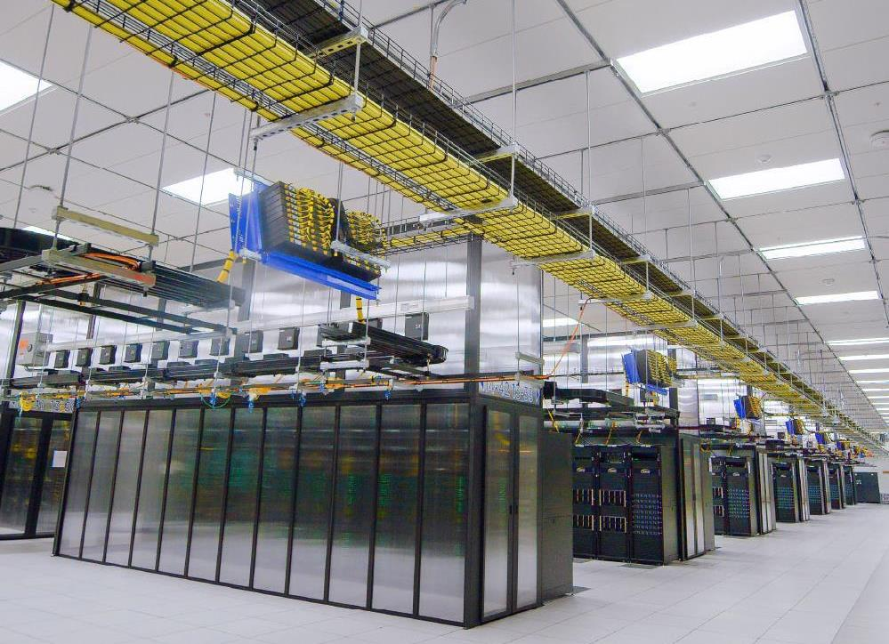


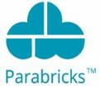









Experts at AI Factory Infrastructure
Enterprise infrastructure designed to support advanced workloads with optimal performance and stability at scale
AI FACTORY
AI & HPC Applications
User Workloads
HPC Workloads
Analytics/ML Workloads
AI/DL Workloads
Platform Foundation
Design
Build
Deploy
Manage
Data Center
Cloud
Software Technologies
Software Technologies
Compute & GPU Technologies
Compute & GPU Technologies
Data Technologies
Data Technologies
Data Center Infrastructure
Secure Cloud Infrastructure

Slide 5
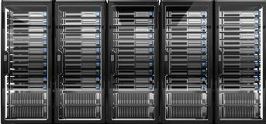

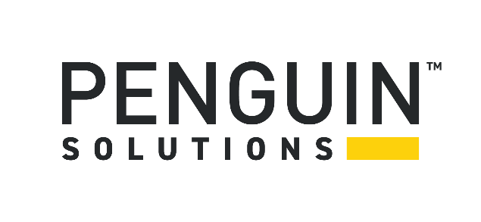


Penguin: Proven AI Factory Delivery at Scale
ChatGPT trained on
10,000 GPUs
Google A3 cluster
26,000 GPUs
Penguin Manages
50,000+ GPUs

Slide 6
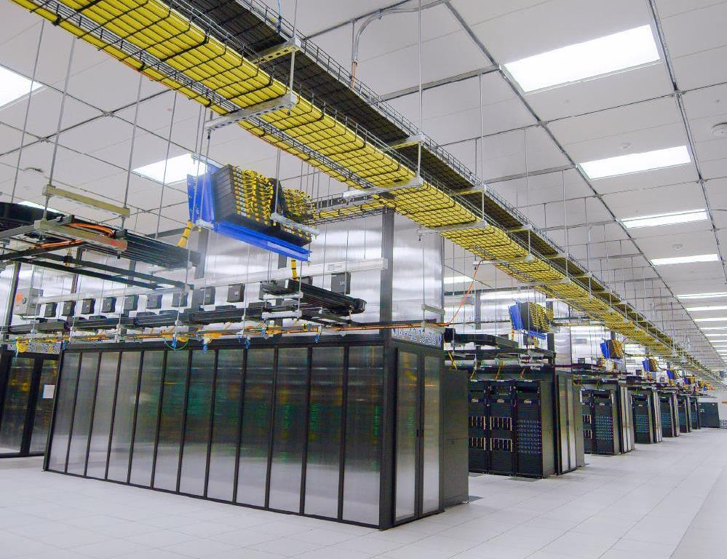

Customer Profile — Meta
Business Challenge
  Urgently needed large-scale AI platform capable
  to support key product and innovation initiatives
  Co-development of a leading-edge technology solution
  DevOps needs for HPC/AI at scale
Meta AI Research SuperCluster (RSC)
  16,000 A100 GPUs
  500 petabyte of storage
  40,000 networking links
  200 Gb/s HDR InfiniBand per GPU
  5 exaFLOPS of mixed precision compute
  Delivered in November 2022 and continue to provide managed services
Notes:
Reference: https://ai.facebook.com/blog/ai-rsc/
24 January 2022

Slide 7
Penguin’s Value is Based On Partnership with Our Customers
“
Working in partnership with our implementation partner, Penguin Computing, we improved our overall cluster management. By the time we completed the second phase of building RSC, availability stayed above 95 percent on a consistent basis. This was no small feat given that we added a 10K GPU cluster while concurrently running multiple research projects.
We now have a template for building large GPU clusters that is repeatable and reliable.
”
18 May 2023

Slide 8
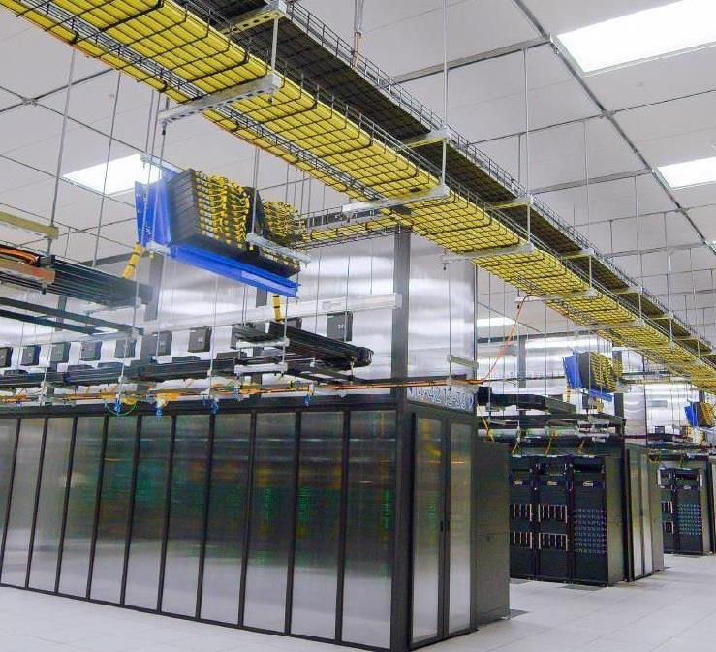
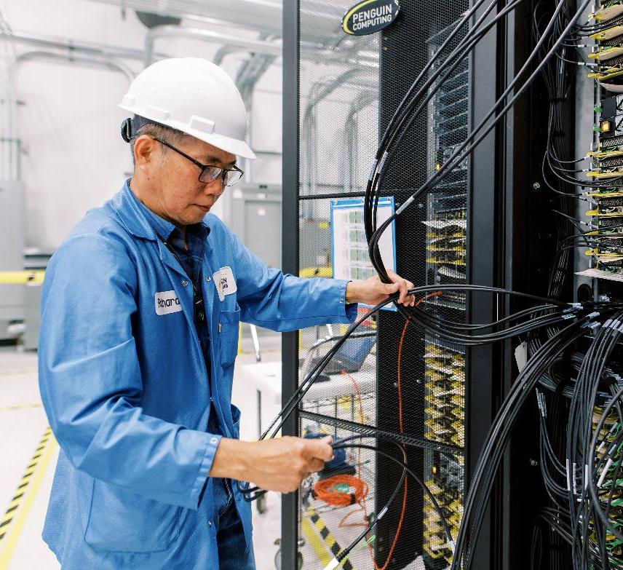
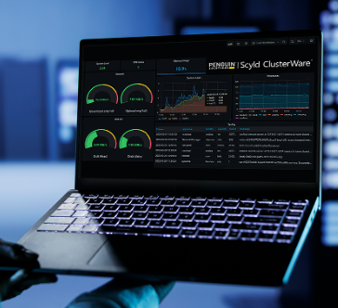

Challenges - AI Factories and Accelerated Computing at Scale
COMPLEX DESIGN
New workload & architecture AI clusters are highly sensitive at scale Requirement to blend multiple networks & processor types
Intricate BUILD
Supply chain delays with specialty critical components Complex build process to achieve throughput Lack of software suite for deployment at scale
Lengthy Deployment
Complex on-site power, cooling, network, and security integration Need for pre-production performance and throughput validation Production cluster monitoring
PRECISION MANAGEMENT
Specialty components with unique failure signatures Performance issues drive significant financial impact User workloads interrupted and training time lost
Notes:
There are 3 main challenges in Modern AI Factories:
You need specialized skills to design AI factories that deliver the expected performance, security, stability and scalability.
For example: it’s the first time in history that we need to combine GPU based compute, InifiniBand Networking, and high speed storage. Each of these elements was used at scale individually, but no one had even brought them together in large clusters. And it’s not easy.
You need specialized skills to build highly complex data centers with new computing, networking and storage technologies that have never worked at such scale yet.
You need specialized skills to manage such large infrastructure and know how to tweak, optimize, troubleshoot the AI factories with issues never seen before by anyone in the world.
For example, the tweaking by specialists gives you several % points of improved availability of your infrastructure. Given the total cost of large AI factories, each % means very significant savings for your company. Like tweaking the aerodynamics of a Formula 1 car will give you the few mph that makes you a winner in a race.

Slide 9
Our Value - AI Factories and Accelerated Computing at Scale
DESIGN
De-risking investment through proven architectures Experience at scale Planning for performance, security and scalability
BUILD
In-Factory rack, cable, and burn-in testing enables smooth on-site deployments Expert cluster integration Validated software stack reduces compatibility issues
Deploy
Penguin software for deep cluster health monitoring End-to-End Project Management accelerates availability Planning for performance, security and scalability
MANAGE
Driving uptime and throughput for large scale environments NVIDIA-certified Managed Services Engineers SLA-based system management and reporting
Notes:
There are 3 main challenges in Modern AI Factories:
You need specialized skills to design AI factories that deliver the expected performance, security, stability and scalability.
For example: it’s the first time in history that we need to combine GPU based compute, InifiniBand Networking, and high speed storage. Each of these elements was used at scale individually, but no one had even brought them together in large clusters. And it’s not easy.
You need specialized skills to build highly complex data centers with new computing, networking and storage technologies that have never worked at such scale yet.
You need specialized skills to manage such large infrastructure and know how to tweak, optimize, troubleshoot the AI factories with issues never seen before by anyone in the world.
For example, the tweaking by specialists gives you several % points of improved availability of your infrastructure. Given the total cost of large AI factories, each % means very significant savings for your company. Like tweaking the aerodynamics of a Formula 1 car will give you the few mph that makes you a winner in a race.

Slide 10

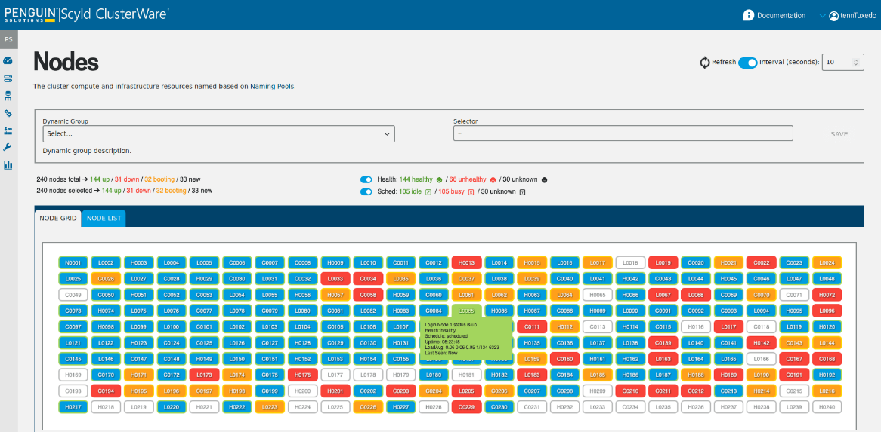
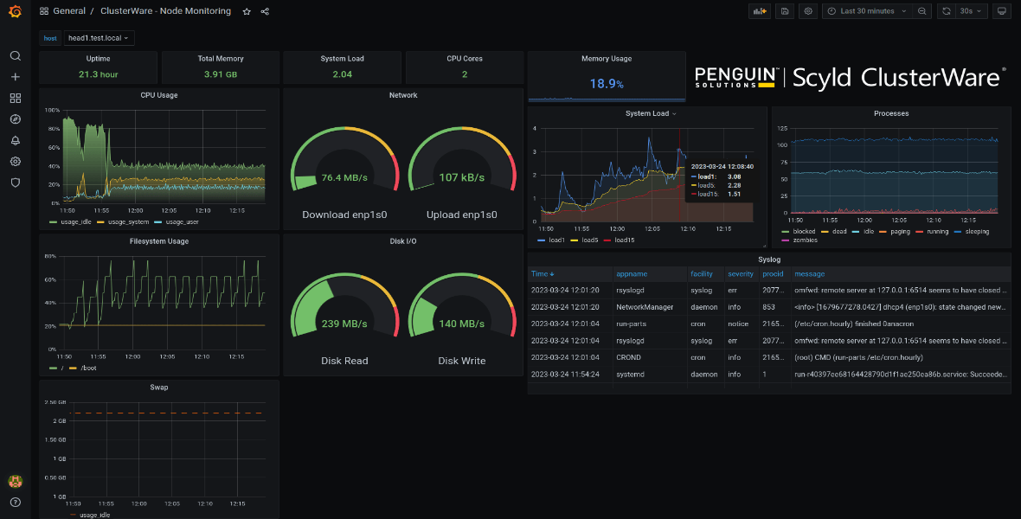
Scyld Clusterware
AI Factory Enablement at Scale
Penguin-developed cluster management software that transforms raw hardware, network, and software resources into high-performance AI Factory platforms.
Streamline complexity
Rapid provisioning & extensibility
Advanced workload scheduler support
Cluster health monitoring & alerting
Full DevOps integration
Highly secure

Slide 11
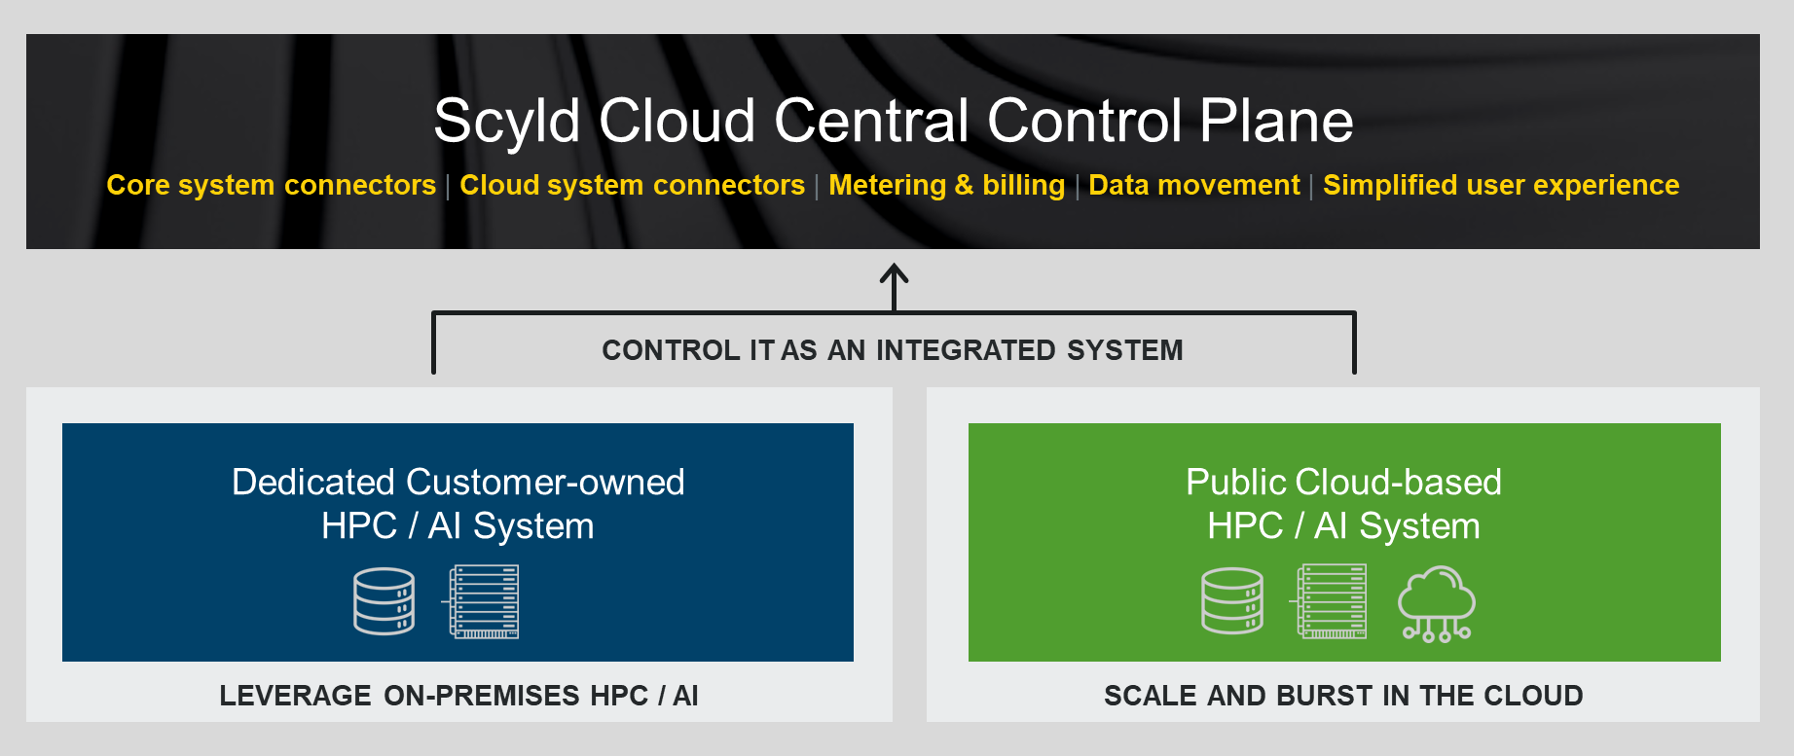
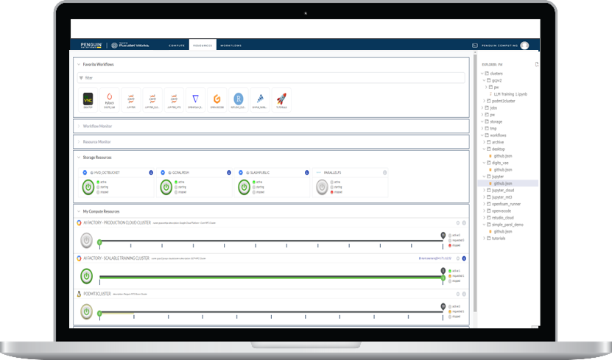
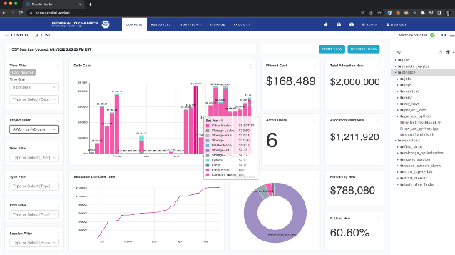
Scyld Cloud Central
One Stop Shop for Hybrid Deployment
Penguin software platform for hybrid cloud management that enables rapid system deployment in the cloud and easy integration of on-premises AI and HPC cluster capacity as solutions come online.
Hybrid Capability: Cloud and On-Premises
Tailor cloud clusters to user needs
Library of pre-built application workflows
Integrated cost management & budget guardrails
Elastic scaling for both data and compute

Slide 12
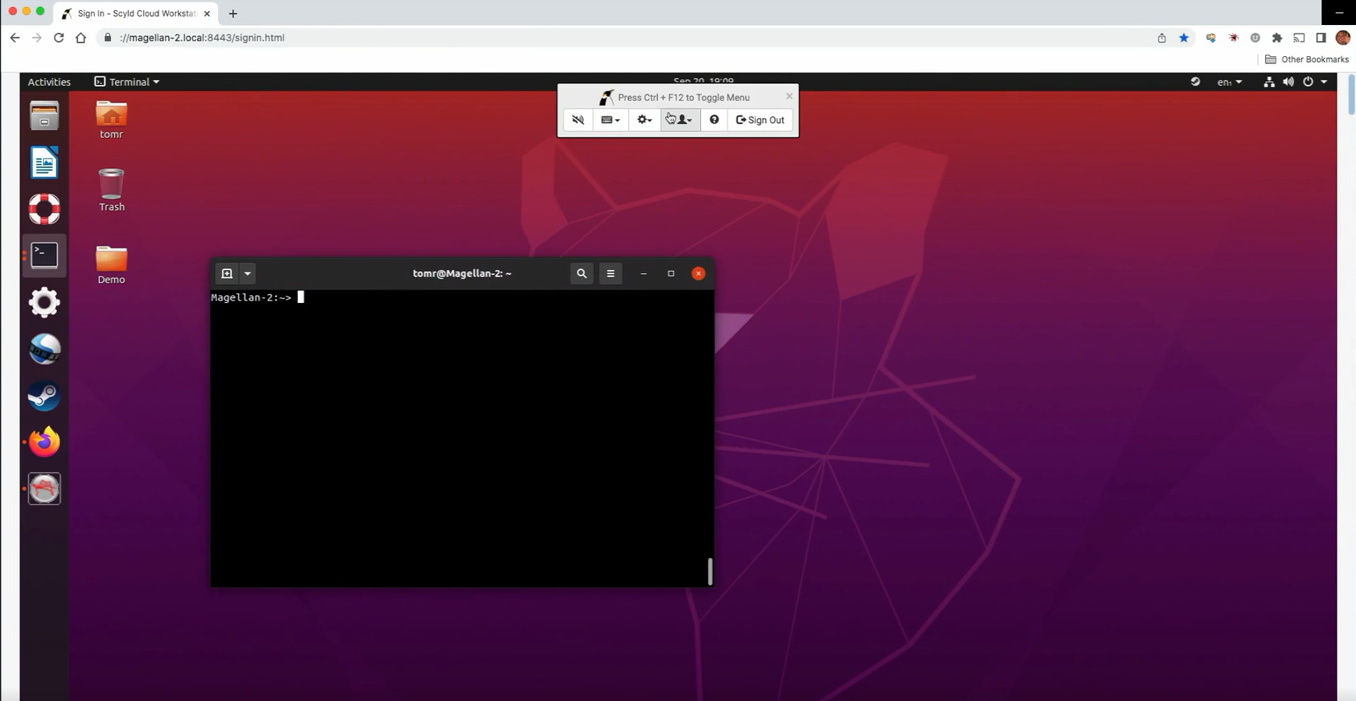
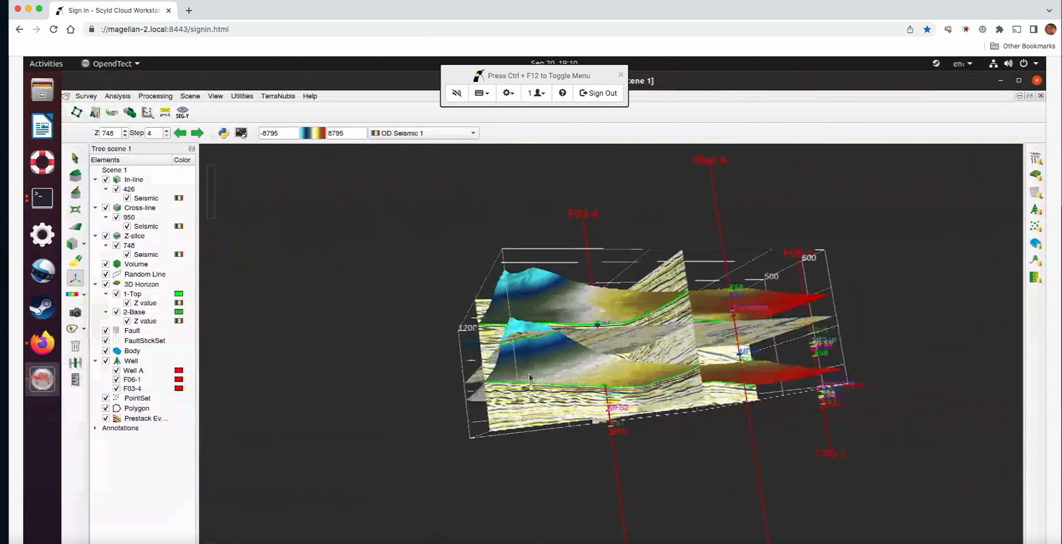
Scyld Cloud Workstation
Secure Remote Application Access
Penguin software platform for secure virtual desktop infrastructure (VDI). High-fidelity access by users and data scientists to remote applications running in the cloud or in remote data centers.
Remote user collaboration on shared desktops
No client installation required
Applications can access and manage massive data sets without moving data
60 frames per second video refresh
Optimized for low bandwidth connections

Slide 13
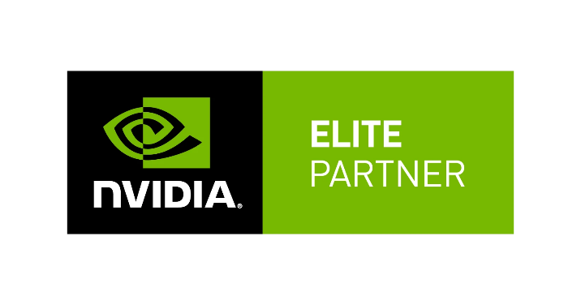
Complete Portfolio
Design, Deployment, and Management Services
Design Services
Workflow Design
Software Orchestration
Compute Performance
Multi-Node Communication
Data Storage and Data Tiering
Data Ingest and Egest
Environment Sizing
Cloud Solution Design
Instance Type Selection
CPU / GPU / Memory Options
Network Bandwidth Requirements
Software Compatibility
Data Ingest and Egress
On-Demand and Spot Instances
Deployment Services
Stand Up and Initialization
User, Group, Project Configuration
Cluster Configuration
Sample Deployment and Testing
Job Performance Characterization
Hosting Services
Co-Lo Hosting for Private Clouds
Penguin Data Center
Customer Data Center
Power, Space, and Cooling Management
As-a-Service Billing
Certified NVIDIA DGX-Ready Managed Services Partner
Managed Services
System Administration
Complete Hands-Off Experience
Augment Existing IT Capabilities
Collaborate with Penguin Support
Tens to Thousands of Servers
Terabytes to Exabytes of Data
Multi Cloud & Data Center Support

Slide 14
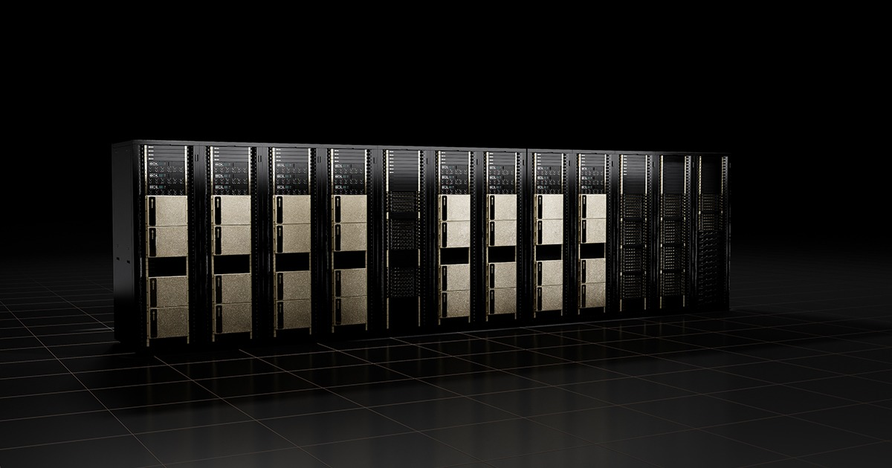
Guidance and Flexibility: End to End AI Factory Journey
1 | RAPID AI FACTORY CLOUD ACCESS
 | Cloud-first availability in parallel with Penguin factory system build Concurrently to AI cluster build, the Penguin team initializes Scyld Cloud Central management access for immediate productivity gains.
2 | ON-PREMISES DEPLOYMENT
 | Solution deployment, integration, and performance validation Deliver, integrate, and deploy on-premises Penguin cluster, and connect to the existing Scyld Cloud Central management platform.
3 | HYBRID MANAGEMENT
 | Flexible operations with cross-system data access and monitoring Enable data synchronization between the on-premises and cloud-based environments so that workloads can run at either site - or both!

Slide 15
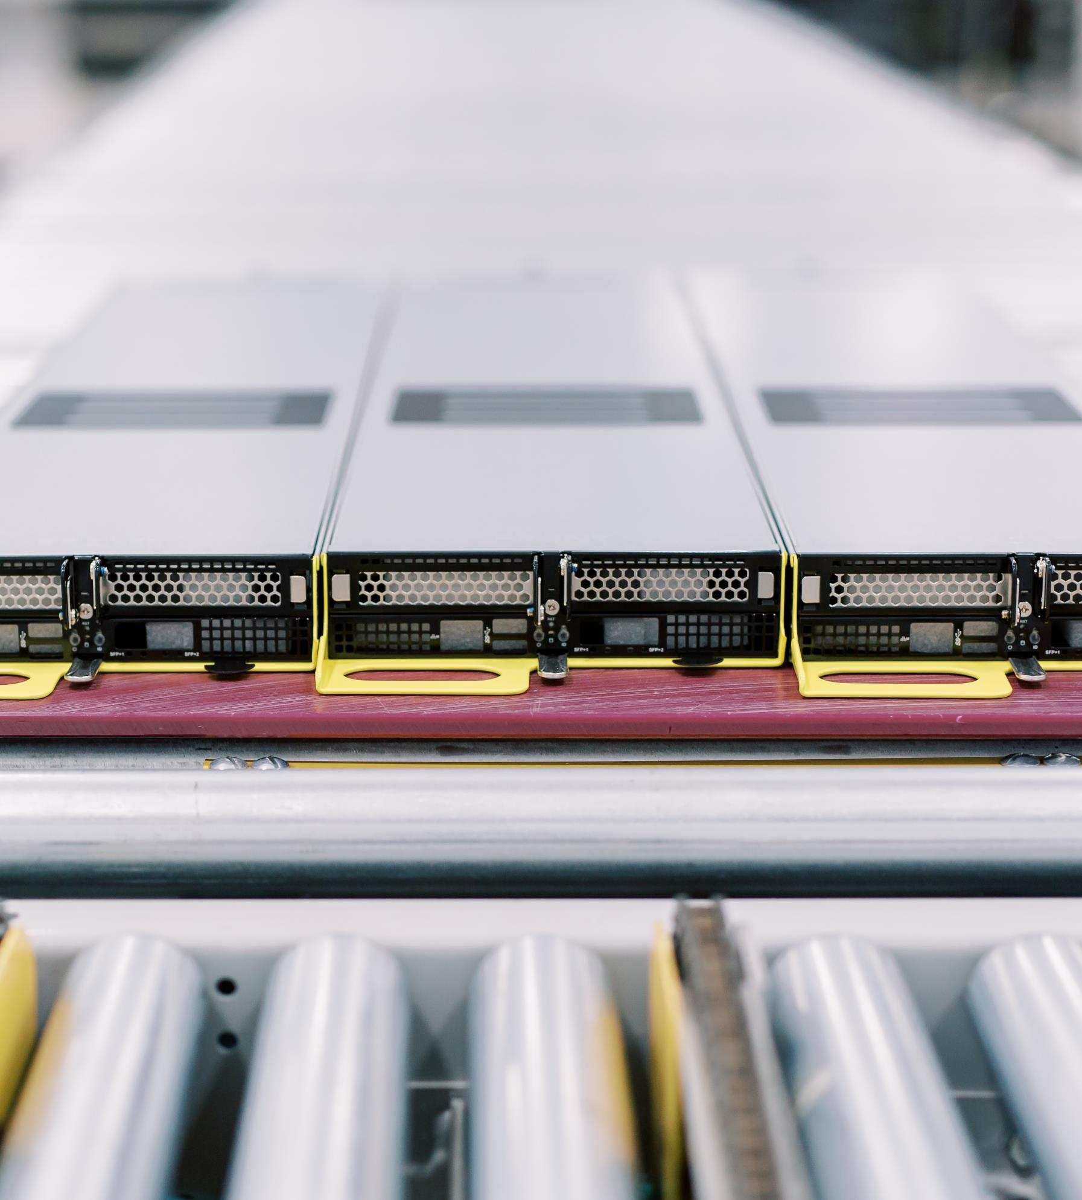
Next Steps
AI & Accelerated Computing Infrastructure Workshop
1
Schedule an interactive session with Penguin Solutions experts
2
Explore opportunities and priorities
3
Scope requirements for AI and Accelerated Computing infrastructure
4
Define a high-level roadmap for system deployment and timing

Slide 16
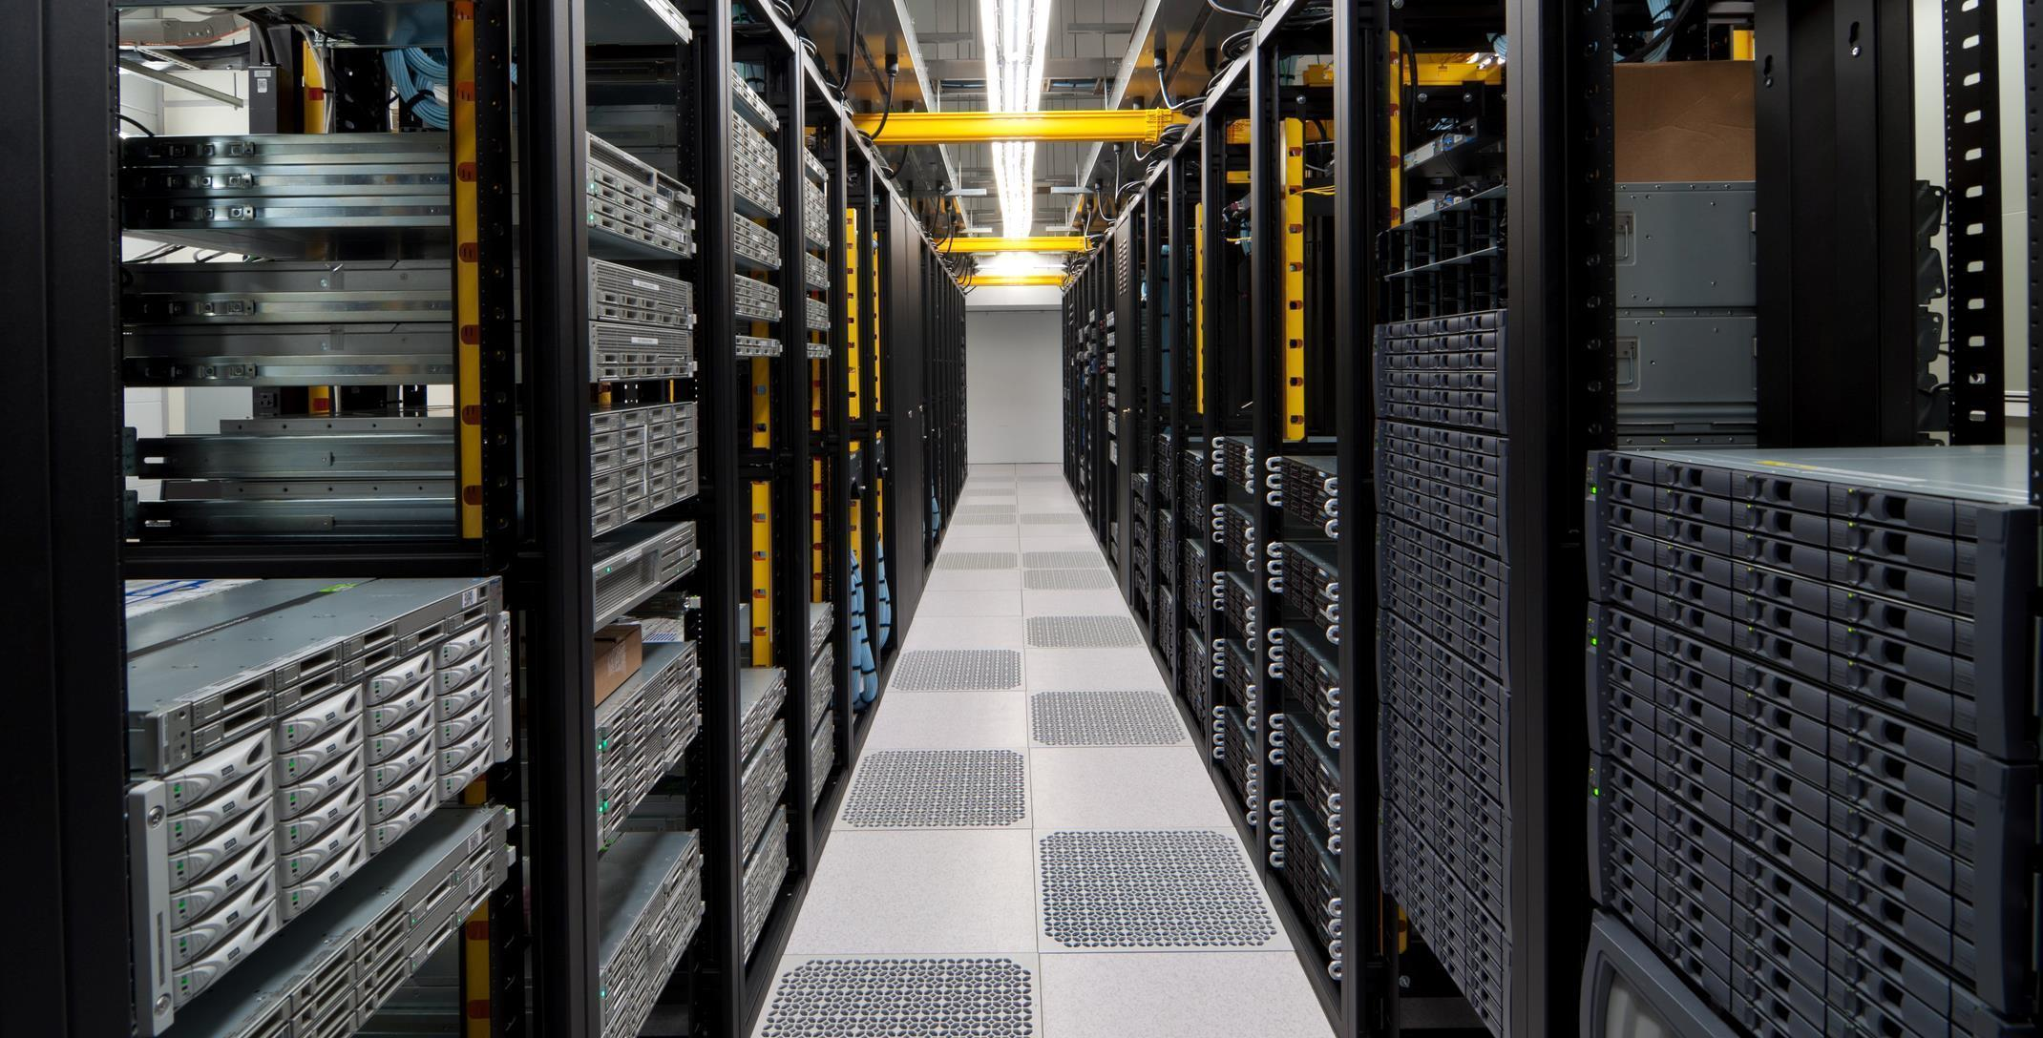
// WE CAN HELP YOU
BE
FIRST
TO THE
FUTURE
1999 //
// 2023
Notes:
Describe a bit of your history in the AI Supercomputer space and what you can offer your prospective client.
Mission
To accelerate and amplify customers’ success by helping them leverage the power of technology.
Vision
To expand our reach as a leading technology partner within our markets and across the continuum of edge, core, and cloud.
Position
Allies in AI, HPC and Edge: We’re the people to partner with when you’re facing the most complex and consequential data project of your career.

